Slide 1

Build a Business-Aligned IT Strategy
Success depends on IT initiatives clearly aligned to business goals, IT excellence, and driving technology innovation.
Info-Tech Research Group Inc. is a global leader in providing IT research and advice. Info-Tech’s products and services combine actionable insight and relevant advice with ready-to-use tools and templates that cover the full spectrum of IT concerns.
© 1997-2021 Info-Tech Research Group Inc.

Slide 2
Table of Contents
Section | Title
1 | Establish the Scope of Your IT Strategy
 | Construct your mission and vision statements Elicit your guiding principles and finalize scope
2 | Review Performance Over the Past Fiscal Year
 | Review and analyze CEO-CIO Alignment data Review and analyze CIO Business Vision diagnostic data Review and analyze MGD data Finalize year in review
3 | Build Your Key Initiative Plan
 | Elicit business context from the CIO and IT team Identify key initiatives that support the business Identify key initiatives that enable IT excellence Identify initiatives that drive technology innovation Construct your strategy roadmap
4 | Define Your Operational Strategy
 | Establish your strategic governance (KPIs, stakeholder management) Organizational changes Budget Technology roadmap support by all functional areas of IT Next steps and refresh strategy

Slide 3



Executive Summary
IT strategies are often nonexistent or ineffective.
Three-quarters of surveyed CEOs value tech leaders with experience fostering operational stability and strategic business alignment,³ however…
Follow Info-Tech’s approach to developing a strong IT strategy.
According to the Management and Governance diagnostic (MGD), 74.6% of organizations have an IT strategy process they feel is ineffective.¹
IT does not do a good job of communicating their support for business goals, therefore, 23.6% of CXOs still feel that their goals are unsupported by IT.²
IT departments that have not developed IT strategies experience alignment, organization, and prioritization issues.
Use Info-Tech’s industry-focused approach to discern the business context.
Clearly communicate to business executives how IT will support the organization’s key objectives and initiatives using the Strategy Presentation Template.
Use Info-Tech’s Prioritization Tool to help make project decisions in a holistic manner that allows for the selection of the most-valuable initiatives to become part of the IT strategic roadmap.
The CIO is seen as an order taker by business executives. This usually results in the demands on IT far outstripping the IT budget.
Projects and initiatives are not prioritized around business objectives. Synergies and dependencies are recognized too late. Projects are often late or put on hold because of sudden changes to business requirements.
Info-Tech Insight
A CIO has three roles: enable business productivity, run an effective IT shop, and drive technology innovation. Your IT strategy must reflect these three mandates and how IT strives to fulfill them.
1: Info-Tech, Management and Governance Diagnostic; n=1,931
2: Info-Tech, CEO-CIO Alignment Diagnostic; n=863
3: CIO Journal, 2020

Slide 4




Info-Tech’s approach
1
01
Establish the Scope of Your IT Strategy
Establish the scope of your IT strategy by defining IT’s mission and vision statements and guiding principles.
2
Review IT Performance From Last Fiscal Year
04
A retrospective of IT’s performance helps recognize the current state while highlighting important strategic elements to address going forward.
02
3
Build Your Key Initiative Plan
Elicit the business context and identify strategic initiatives that are most important to the organization and build a plan to execute on them.
03
4
Define IT’s Operational Strategy
Evaluate the foundational elements of IT’s operational strategy that will be required to successfully execute on key initiatives.

Slide 5


Info-Tech’s methodology for IT Strategy
01
02
03
04
Business Context
Key Initiative Plan
Operational Strategy
Executive Presentation
Inputs | Business Strategy Industry Capability Map | Business Context Information Diagnostic Reports to Assess Current State Last Fiscal Strategy | Key Initiatives List Last Fiscal Operational Strategy | Initiatives & Roadmap Operational Strategy
Outputs | Business Context Information for Step 2: Business goals Organizational objectives & initiatives Industry customized capability map | IT Strategy Information for Approval: Strategy scope Year in review Key initiative plan & profiles Goals cascade Roadmap | Operational Strategy Information for Step 4: Stakeholder management Metrics & targets Risk management Organizational changes Budget Functional roadmap & next steps | Executive Presentations for: Business executives IT team Board Org-wide key highlights
Service
Pre-Workshop
Industry-Specific
Guided Implementation
IT Strategy Workshop
IT Strategy Workshop
IT Strategy Workshop

Slide 6
Info-Tech’s methodology for IT Strategy
01
02
03
04
Business Context
Key Initiative Plan
Operational Strategy
Executive Presentation
 | Business Strategy Information | Industry Capability Map | Current-State Assessment | Last Fiscal Strategy | Key Initiatives List | Last Fiscal Operational Strategy | Initiatives & Roadmap | Operational Strategy
Light-Weight
Assessment
Conduct Business Goals Exercise
Download and Use Segment-Level Capability Map Template
Interview CEO, Peers, and IT Managers
Brainstorm Success Stories
Brainstorm List of Projects Approved by Business
Collect Minimal Operational Strategy Data
Collect Minimal Initiatives & Roadmap Data
Collect Minimal Operational Strategy Data
Follow Business Context Methodology
Conduct Half-Day Industry Guided Implementation
Launch Business Vision, CEO-CIO Alignment, and MGD Diagnostics
Gather & Organize Past Fiscal Strategy Documents
Conduct Strategy Workshop
Conduct Strategy Workshop
Conduct Strategy Workshop
Conduct Strategy Workshop
Thorough
Analysis

Slide 7


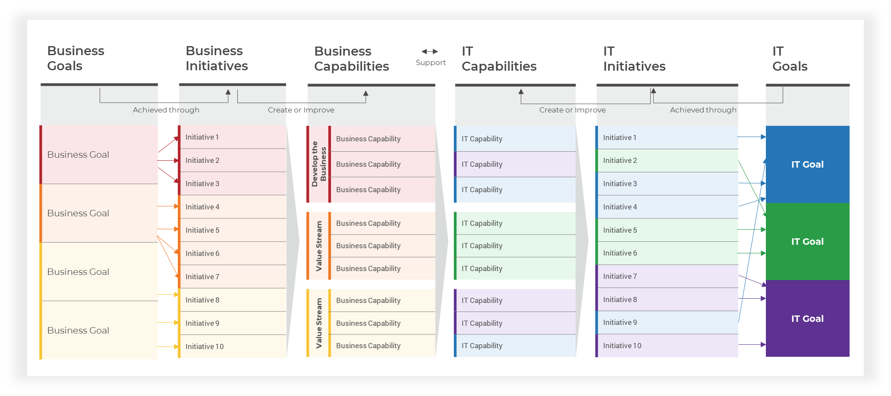
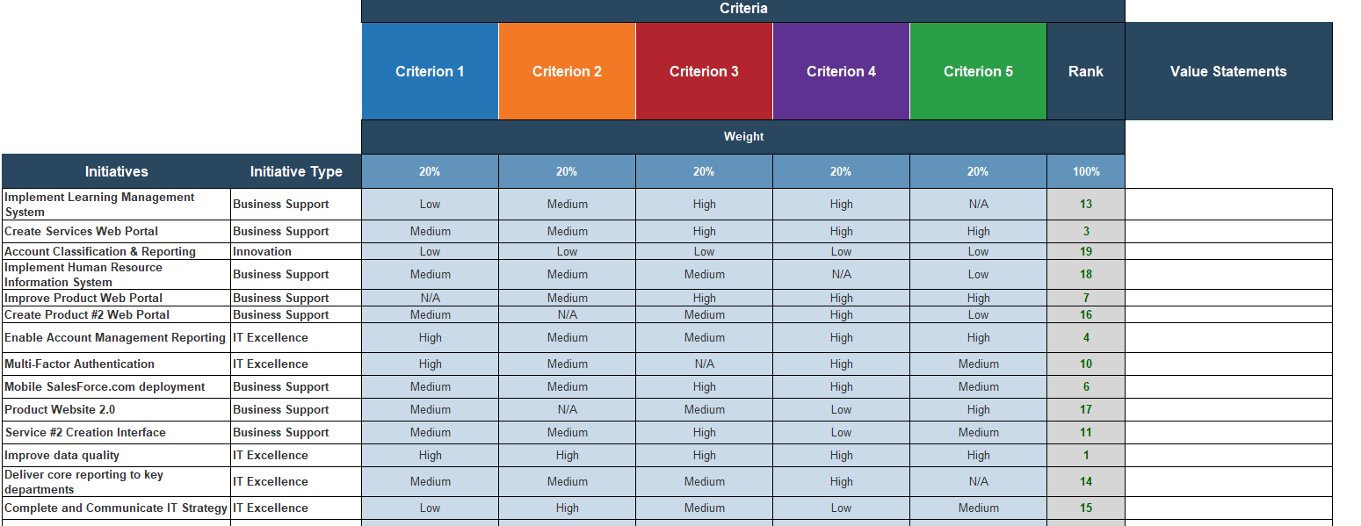
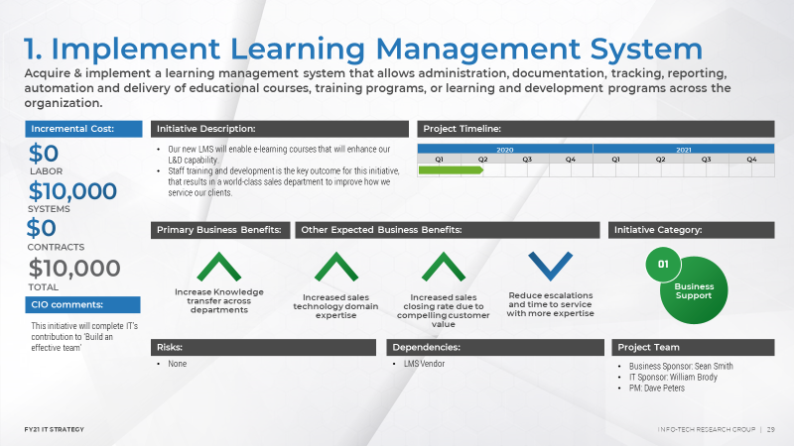
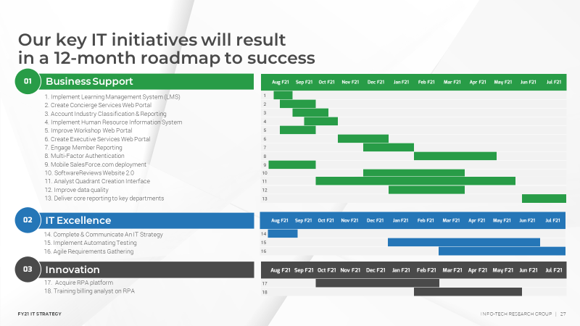
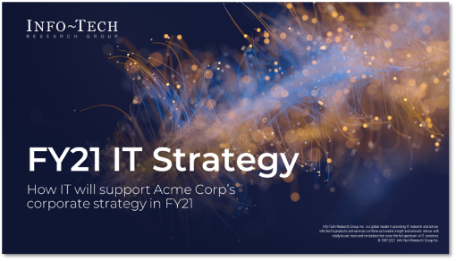
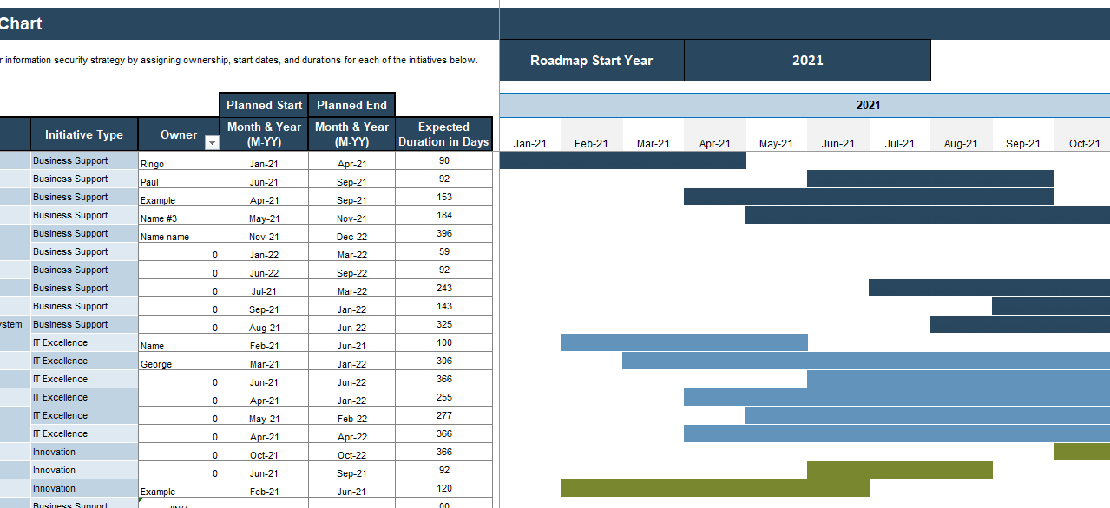
Blueprint deliverables
Key deliverable:
The IT Strategy Workbook supports each step of this blueprint to help you accomplish your goals:
IT Strategy Presentation Template
A highly visual and compelling presentation template that enables easy customization and executive-facing content.
Goals Cascade Visual
Initiative Prioritization
Elicit business context and use the workbook to build your custom goals cascade.
Use the weighted scorecard approach to evaluate and prioritize your strategic initiatives.
Roadmap/ Gantt Chart
Populate your Gantt chart to visually represent your key initiative plan over the next 12 months.

Slide 9

Guided Implementation
A Guided Implementation (GI) is a series
of calls with an Info-Tech analyst to help implement our best practices in your organization.
A typical GI is between 8 to 12 calls over the course of 2 to 4 months.
What does a typical GI on this topic look like?
Phase 0
Phase 3
Phase 1
Phase 2
Phase 4
Call #1: Discuss business context and customize your organization’s capability map.
Call #2: Identify mission and vision statements and guiding principles to discuss strategy scope.
Call #3: Assess year-in-review data and evaluate performance.
Call #5: Identify strategic initiatives and required information.
Call #7: Discuss and identify appropriate operational strategy components.
Call #4: Discuss diagnostic data results and success stories.
Call #6: Discuss how to build your roadmap.
Call #8: Summarize results and plan next steps.
Info-Tech Research Group | 9

Slide 10
Workshop Agenda
Contact your account representative for more information. workshops@infotech.com 1-888-670-8889
 | Session 0 (Pre-Workshop) | Session 1 | Session 2 | Session 3 | Session 4 | Session 5 (Post-Workshop)
Activities | Elicit Business Context | Establish the Scope of Your IT Strategy | Build Your Key Initiative Plan | Build Your Key Initiative Plan (cont.) | Define Your Operational Strategy | Document Strategy
 | 0.1 Complete recommended diagnostic programs. 0.2 Interview key business stakeholders, as needed, to identify business context: business goals, initiatives, and the organization’s mission and vision. 0.3 (Optional) CIO to compile and prioritize IT success stories. | 1.1 Review/validate the business context. 1.2 Construct your mission and vision statements. 1.3 Elicit your guiding principles and finalize IT strategy scope. | 2.1 Identify key IT initiatives that support the business. 2.2 Identify key IT initiatives that enable operational excellence. 2.3 Identify key IT initiatives that drive technology innovation. 2.4 Consolidate and prioritize (where needed) your IT initiatives. | 3.1 Determine IT goals. 3.2 Complete goals cascade. 3.3 Build your IT strategy roadmap. | 4.1 Identify metrics and targets per IT goal. 4.2 (Optional) Identify required skills and resource capacity. 4.3 Discuss next steps and wrap-up. | 5.1 Complete in-progress deliverables. 5.2 (Optional) Set up review time for workshop deliverable.
Outcomes | 1. Diagnostics reports (CIO Business Vision, Management and Governance Diagnostic, CEO-CIO alignment) 2. IT Strategy Workbook – Business Context | 1. IT strategy scope (IT mission, vision, and guiding principles) | 1. List of key IT initiatives | 1. Goals cascade 2. Roadmap (Gantt chart) | 1. IT metrics and targets 2. IT resourcing changes 3. Next steps and strategy refresh schedule | 1. IT strategy presentation

Slide 11

Workshop Requirements
Launch the CIO Business Vision diagnostic.
Launch the CEO-CIO Alignment diagnostic.
Launch the Management and Governance diagnostic.
Gather all historical diagnostic reports (if they exist).
Gather business strategy documents and find information on:
Business goals
Business initiatives
Business capabilities to create or enhance
(If this doesn’t exist for your organization, contact your Info-Tech Account Manager to get started.)
Interview the following stakeholders to uncover business context information:
CEO
CFO
Gather information on last fiscal year’s strategy. Particularly information on:
IT goals
Specific IT initiatives/projects completed
Project start and end dates
Metrics and targets and progress made towards them
Last fiscal year’s budget information
Organizational structure
Launch Diagnostics
Business Inputs
IT Inputs
Contact your Account Manager to get started.
Download the Business Context Discovery Tool

Slide 12
Phase 1
This phase will walk you through the following activities:
How to build IT mission and vision statements
How to elicit IT guiding principles
How to finalize and communicate your IT strategy scope
This phase involves the following participants:
CIO
Senior IT Team
Establish Scope of Your IT Strategy
Phase 1
1.1 Mission & Vision Statement
1.2 Guiding Principles
1.3 Finalize Scope
Phase 2
Build a Business-Aligned IT Strategy
Phase 3
Phase 4

Slide 13
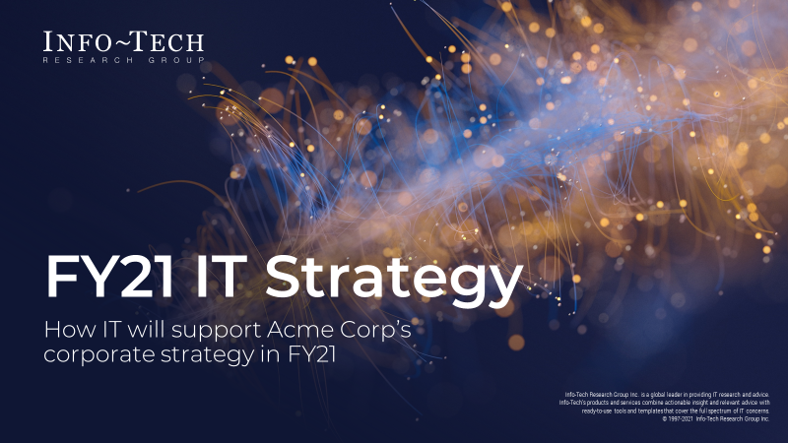
To complete this phase, you will need:
IT Strategy Presentation Template
Use the IT Strategy Presentation Template to document the results from the following activities:
Mission and Vision Statements
IT Guiding Principles

Slide 14


IT must aim to support the organization’s mission and vision
1.1 Mission & Vision
A mission statement:
Focuses on today and what an organization does to achieve it.
Drives the company.
Answers: What do we do? Whom do we serve? How do we service them?
A mission statement focuses on the purpose of the brand; the vision statement looks to the fulfillment of that purpose.
A vision statement:
Focuses on tomorrow and what an organization ultimately wants to become.
Gives the company direction.
Answers: What problems are we solving? Who and what are we changing?
A vision statement provides a concrete way for stakeholders, especially employees, to understand the meaning and purpose of your business. However, unlike a mission statement – which describes the who, what, and why of your business – a vision statement describes the desired long-term results of your company's efforts.
Source: Business News Daily, 2020

Slide 15
Characteristics of a mission & vision statement
1.1 Mission & Vision
A strong mission statement has the following characteristics:
Articulates the IT function’s purpose and reason for existence
Describes what the IT function does to achieve its vision
Defines the customers of the IT function
Is:
Compelling
Easy to grasp
Sharply focused
Concise
A strong vision statement has the following characteristics:
Describes a desired future achievement
Focuses on ends, not means
Communicates promise
Is:
Concise; no unnecessary words
Compelling
Achievable
Measurable

Slide 16



Derive the IT mission and vision statements from the business’
1.1 Mission & Vision
Ensure there is alignment between the business and IT statements.
Note: Mission statements may remain the same unless the IT department’s mandate is changing.
Begin the process by identifying and locating the business mission and vision statements.
~
Business Mission
IT Mission
Corporate Websites
Business Strategy Documents
~
Business Vision
IT Vision
Business Executives

Slide 17
1.1 Construct mission and vision statements
1.1 Mission & Vision
Objective: Help teams define their purpose (why they exist) to build a mission statement (if one doesn't already exist).
60 minutes
Step 1:
Gather the IT strategy creation team and revisit your business context inputs, specifically the corporate mission statement.
Begin by asking the participants:
What is our job as a team?
What’s our goal? How do we align IT to our corporate mission?
What benefit are we bringing to the company and the world?
Ask them to share general thoughts in a check-in.
Step 2:
Share some examples of IT mission statements.
Example: IT provides innovative product solutions and leadership that drives growth and success.
Provide each participant with some time to write their own version of an IT mission statement.
Step 3:
This step involves reviewing individual mission statements, combining them, and building one collective mission statement for the team.
Consider the following approach to build a unified mission statement:
Use the 20x20 rule for group decision making. Give the group no more than 20 minutes to craft a collective team purpose with no more than 20 words.
As a facilitator, provide guidelines on how to write for the intended audience. Business stakeholders need business language.
Refer back to the corporate mission statement periodically and ensure there is alignment.
Document your final mission statement in your IT Strategy Presentation Template.
Source: Hyper Island Toolbox

Slide 18
1.1 Construct mission and vision statements (cont.)
1.1 Mission & Vision
Objective: Help teams define their ideal culture (how they work together to achieve their purpose) to a vision statement.
60 minutes
Step 4:
Gather the IT strategy creation team and revisit your business context inputs, specifically the corporate vision statement.
Share one or more examples of vision statements.
Provide participants with sticky notes and writing materials, and ask them to work individually for this step.
Ask participants to brainstorm using the following questions:
What is the desired future state of the IT organization?
How should we work to attain the desired state?
How do we want IT to be perceived in the desired state?
Provide participants with guidelines to build descriptive, compelling, and achievable statements regarding their desired future state.
Regroup as a team and review participant answers.
Step 5:
Ask the team to post their notes on the wall.
Have the team group the words that have a similar meaning or feeling behind them – these will create themes.
When the group is done categorizing the statements into themes, ask if there's anything missing. Did they ensure alignment to the corporate vision statement? Are there any elements missing when considering alignment back to the corporate vision statement?
Step 6:
Consider each category as a component of your vision statement.
Review each category with participants; define what the behavior looks like when it is being met and what it looks like when it isn’t.
As a facilitator, provide guidelines on word-smithing and finessing the language.
Refer back to the corporate vision statement periodically and ensure there is alignment.
Document your final mission statement in your IT Strategy Presentation Template.
Source: Hyper Island Toolbox

Slide 19

1.1 Construct mission and vision statements (cont.)
1.1 Mission & Vision
Input | Output
Business mission statement Business vision statement | IT mission statement IT vision statement
Materials | Participants
Screen Projector Sticky notes Markers Whiteboard Paper Collaboration/brainstorming tool (whiteboard, flip chart, digital equivalent) | CIO Senior IT Team
Tips for Online Facilitation
Pick an online whiteboard tool that allows participants to use a large, zoomable canvas.
Set up each topic at a different area of the board; spread them out just like you would do it on the walls of a room.
Invite participants to zoom in and visit each section and add their ideas as sticky notes once you reach that section of the exercise.
If you’re not using an online whiteboard, we’d recommend using a collaboration tool such as Google Docs to collect the information for each step under a separate heading. Invite everyone into the document but be very clear in regard to editing rights.
Pre-create your screen deck and screen share this with your participants through your videoconferencing software. We’d also recommend sharing this so participants can go through the deck again during the reflection steps.
When facilitating group discussion, we’d recommend that participants use non-verbal means to indicate they’d like to speak. You can use tools like Teams’ “raise hand” tool, a reaction emoji, or just have people put their hands up. The facilitator can then invite that person to talk.
Download the IT Strategy Presentation Template and document your mission and vision statements in section 1.

Slide 20
IT mission statements demonstrate the IT function’s purpose
The IT mission statement specifies the function’s purpose or reason for being. The mission should guide each day’s activities and decisions. The mission statements use simple and concise terminology and speak loudly and clearly, generating enthusiasm for the organization.
Sample IT Mission Statements:
To provide infrastructure, support, and innovation in the delivery of secure, enterprise-grade information technology products and services that enable and empower the workforce at [Company Name].
To help fulfil organizational goals, the IT department is committed to empowering business stakeholders with technology and services that facilitate effective processes, collaboration, and communication.
The mission of the information technology (IT) department is to build a solid, comprehensive technology infrastructure; to maintain an efficient, effective operations environment; and to deliver high-quality, timely services that support the business goals and objectives of ABC Inc.
The IT department has operational, strategic, and fiscal responsibility for the innovation, implementation, and advancement of technology at ABC Inc. in three main areas: network administration and end-user support, instructional services, and information systems. The IT department provides leadership in long-range planning, implementation, and maintenance of information technology across the organization.
The IT group is customer-centered and driven by its commitment to management and staff. It oversees services in computing, telecommunications, networking, administrative computing, and technology training.
Strong IT mission statements have the following characteristics:
Articulates the IT function’s purpose and reason for existence
Describes what the IT function does to achieve its vision
Defines the customers of the IT function
Is:
Compelling
Easy to grasp
Sharply focused
Inspirational
Memorable
Concise

Slide 21
Sample mission statements continued
To collaborate and empower our stakeholders, through an engaged team and operational agility, and deliver innovative technology and services.
Through collaboration and agility, empower our stakeholders with innovative technology and services.
To collaborate and empower our stakeholders, by delivering innovative technology and services, with an engaged team and operational agility.
To partner with departments and be technology leaders that will deliver innovative, secure, efficient, and cost-effective services for our citizens.
As a client-centric strategic partner, provide excellence in IM and IT services through flexible business solutions for achieving positive user experience and satisfaction.
Develop a high-performing global team that will plan and build a scalable, stable operating environment.
Through communication and collaboration, empower stakeholders with innovative technology and services.
Build a robust portfolio of technology services and solutions, enabling science-lead and business-driven success.
Guided by value-driven decision making, high-performing teams and trusted partners deliver and continually improve secure, reliable, scalable, and reusable services that exceed customer expectations.
Engage the business to grow capabilities and securely deliver efficient services to our users and clients.
Engage the business to securely deliver efficient services and grow capabilities for our users and clients.

Slide 22
IT vision statements demonstrate what the IT organization “aspires to be”
The IT vision statement communicates a desired future state of the IT organization. The statement is expressed in the present tense. It seeks to articulate the desired role of IT and how IT will be perceived.
Sample IT Vision Statements:
To be a trusted advisor and partner in enabling business innovation and growth through an engaged IT workforce.
The IT organization will strive to become a world-class value center that is a catalyst for innovation.
IT is a cohesive, proactive, and disciplined team that delivers innovative technology solutions while demonstrating a strong customer-oriented mindset.
Develop and maintain IT and an IT support environment that is secure, stable, and reliable within a dynamic environment.
Strong IT vision statements have the following characteristics:
Describes a desired future
Focuses on ends, not means
Communicates promise
Is:
Concise; no unnecessary words
Compelling
Achievable
Inspirational
Memorable

Slide 23
Sample vision statements continued
Alignment: To ensure that the IT organizational model and all related operational services and duties are properly aligned with all underlying business goals and objectives. Alignment reflects an IT operation "that makes sense," considering the business served, its interests and its operational imperatives.
Engagement: To ensure that all IT “vision” stakeholders are fully engaged in technology related planning and the operational parameters of the IT service portfolio. IT stakeholders include the IT performing organization (IT Department), company executives and end-users.
Best Practices: To ensure that IT operates in a standardized fashion, relying on practical management standards and strategies properly sized to technology needs and organizational capabilities.
Commitment to Customer Service: To ensure that IT services are provided in a timely, high quality manner, designed to fill the operational needs of the front-line end-users, working within the boundaries established by business interests and technology best practices.
Quoted From ITtoolkit, 2020

Slide 24
Case Study
1.1 Mission & Vision
INDUSTRY
COMPANY
Acme Corp. was able to construct its IT mission and vison statements by aligning to its corporate mission and vision.
Professional Services
This case study is based on a real company but was anonymized for use in this research.
BUSINESS
IT
We help IT leaders achieve measurable results by systematically improving core IT processes, governance, and critical technology projects.
Mission
Mission
IT provides innovative product solutions and leadership that drives growth and success.
Acme Corp. will grow to become the largest research firm across the industry by providing unprecedented value to our clients.
Vision
Vision
We will relentlessly drive value to our customers through unprecedented innovation.

Slide 25
IT guiding principles set the boundaries of your strategy
1.2 Guiding Principles
Strategic guiding principles advise the IT organization on the boundaries of the strategy.
Guiding principles are a priori decisions that limit the scope of strategic thinking to what is acceptable organizationally, from a budgetary, people, and partnership standpoint. Guiding principles can cover other dimensions as well.
Organizational stakeholders are more likely to follow IT principles when a rationale is provided.
After defining the set of IT principles, ensure that they are all expanded upon with a rationale. The rationale ensures principles are more likely to be followed because they communicate why the principles are important and how they are to be used. Develop the rationale for each IT principle your organization has chosen.
=
IT Guiding Principles
IT Strategy Boundaries

Slide 26
Consider these four components when brainstorming guiding principles
1.2 Guiding Principles
Breadth
of the IT strategy can span across the seven perspectives: people, process, technology, data, process, sourcing, location, and timing.
Defining which of the seven perspectives is in scope for the IT strategy is crucial to ensuring the IT strategy will be comprehensive, relevant, and actionable.
Depth
of coverage refers to the level of detail the IT strategy will go into for each perspective. Info-Tech recommends that depth should go to the initiative level (i.e. individual projects).
Organizational Coverage
will determine which part of the organization the IT strategy will cover.
Planning Horizon
of the IT strategy will dictate when the target state should be reached and the length of the roadmap.

Slide 27
Consider this criteria when brainstorming guiding principle statements
1.2 Guiding Principles
Approach focused | IT principles are focused on the approach, i.e. how the organization is built, transformed, and operated, as opposed to what needs to be built, which is defined by both functional and non-functional requirements.
Business relevant | Create IT principles that are specific to the organization. Tie IT principles to the organization’s priorities and strategic aspirations.
Long lasting | Build IT principles that will withstand the test of time.
Prescriptive | Inform and direct decision making with IT principles that are actionable. Avoid truisms, general statements, and observations.
Verifiable | If compliance can’t be verified, the principle is less likely to be followed.
Easily digestible | IT principles must be clearly understood by everyone in IT and by business stakeholders. IT principles aren’t a secret manuscript of the IT team. IT principles should be succinct; wordy principles are hard to understand and remember.
Followed | Successful IT principles represent a collection of beliefs shared among enterprise stakeholders. IT principles must be continuously “preached” to all stakeholders to achieve and maintain buy-in. In organizations where formal policy enforcement works well, IT principles should be enforced through appropriate governance processes.

Slide 28
Review ten universal IT principles to determine if your organization wishes to adopt them
IT Principle Name | IT Principle Statement
Enterprise value focus | We aim to provide maximum long-term benefits to the enterprise as a whole while optimizing total costs of ownership and risks.
Fit for purpose | We maintain capability levels and create solutions that are fit for purpose without over engineering them.
Simplicity | We choose the simplest solutions and aim to reduce operational complexity of the enterprise.
Reuse > buy > build | We maximize reuse of existing assets. If we can’t reuse, we procure externally. As a last resort, we build custom solutions.
Managed data | We handle data creation, modification, and use enterprise-wide in compliance with our data governance policy.
Controlled technical diversity | We control the variety of technology platforms we use.
Managed security | We manage security enterprise-wide in compliance with our security governance policy.
Compliance to laws and regulations | We operate in compliance with all applicable laws and regulations.
Innovation | We seek innovative ways to use technology for business advantage.
Customer centricity | We deliver best experiences to our customers with our services and products.

Slide 29
1.2 Elicit guiding principles
1.2 Guiding Principles
Input | Output
Four components for eliciting guiding principles Mission and vision statements | IT guiding principles IT strategy scope
Materials | Participants
Sticky notes Whiteboard/flip chart Pens Collaboration/brainstorming tool (whiteboard, flip chart, digital equivalent) | CIO Senior IT Team
Objective: Generate ideas for guiding principle statements with silent sticky note writing.
60 minutes
Gather the IT strategy creation team and revisit your mission and vision statements.
Ask the group to brainstorm answers individually, silently writing their ideas on separate sticky notes. Provide the brainstorming criteria from the previous slide to all team members. Allow the team to put items on separate notes that can later be shuffled and sorted as distinct thoughts.
After a set amount of time, ask the members of the group to stick their notes to the whiteboard and quickly present them. Categorize all ideas into four major buckets: breadth, depth, organizational coverage, and planning horizon. Ideally, you want one guiding principle to describe each of the four components.
If there are missing guiding principles in any category or anyone’s items inspire others to write more, they can stick those up on the wall too, after everyone has presented.
Discuss and finalize your IT guiding principles.
Document your guiding principles in the IT Strategy Presentation Template under section 1.
Download the IT Strategy Presentation Template and document your guiding principles in section 1.
Source: Gamestoming, 2010

Slide 30
Example guiding principles
Alignment: Our IT decisions will align with [our organization’s] strategic plan.
Resources: We will allocate cyberinfrastructure resources based on providing the greatest value and benefit for [the community].
User Focus: User needs will be a key component in all IT decisions.
Collaboration: We will work within and across organizational structures to meet strategic goals and identify opportunities for innovation and improvement.
Transparency: We will be transparent in our decision making and resource use.
Innovation: We will value innovative and creative thinking.
Data Stewardship: We will provide a secure but accessible data environment.
IT Knowledge and Skills: We will value technology skills development for the IT community.
Drive Reduced Costs and Improved Services
Deploy Packaged Apps – Do not Develop – retain business process knowledge expertise – Reduce apps portfolio
Standardize/Consolidate Infrastructure with Key Partners
Use what we Sell, and help Sell
Drive High-Availability Goals: No Blunders
Ensure Hardened Security and Disaster Recovery
Broaden Skills (hard and soft) across the workforce
Improve Business Alignment and IT Governance
Quoted From: Office of Information Technology, 2014; Future of CIO, 2013

Slide 31
Case Study
1.2 Guiding Principles
INDUSTRY
COMPANY
Acme Corp. elicited guiding principles that set the scope of its IT strategy for FY21.
Professional Services
Acme Corp.
We will focus on big-ticket items during the next 12 months.
We will keep the budget within 5%+/- YOY.
The following guiding principles define the values that drive IT’s strategy in FY21 and provide the criteria for our 12-month planning horizon.
We will insource over outsource.
We will develop a cloud-first technology stack.

Slide 32
1.3 Finalize your IT strategy scope
1.3 Finalize Scope
Your mission and vision statements and your guiding principles should the first things you communicate on your IT strategy document.
Why is this important?
Communicating these elements shows how IT supports the corporate direction.
The vision and mission statements will clearly articulate IT’s aspirations and purpose.
The guiding principles will clearly articulate what and how IT plans to support the business strategically.
These elements set expectations with stakeholders for the rest of your strategy.
IT MISSION
IT VISION
IT STRATEGY SCOPE
IT GUIDING PRINCIPLES
Input information into the IT Strategy Presentation Template

Slide 33
Established the scope of your IT strategy
Constructed the IT mission statement to communicate the IT organization’s reason for being.
Constructed the IT vision statement to communicate the desired future state of the IT organization.
Elicited IT’s guiding principles to communicate the overall scope and time horizon for the strategy.

Slide 34
Phase 2
This phase will walk you through the following activities:
How to determine the business value from previous strategies.
How to analyze diagnostic data to review IT’s performance over the last fiscal year.
How to elicit other important data to communicate IT’s success over the last fiscal year.
This phase involves the following participants:
CIO
Senior IT Team
Review Performance From Last Fiscal Year
Phase 2
2.1 Business Value Realized
2.2 Diagnostic Data Analysis
2.3 Additional Year-in-Review Data
2.4 Year-in-Review Completion
Phase 1
Build a Business-Aligned IT Strategy
Phase 3
Phase 4

Slide 35
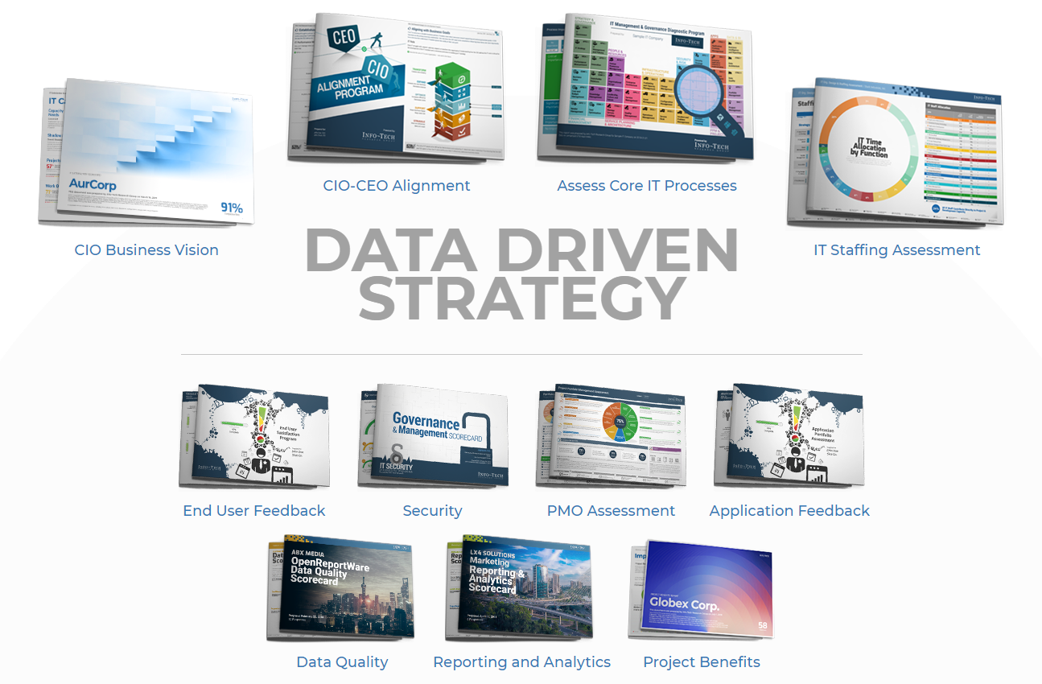
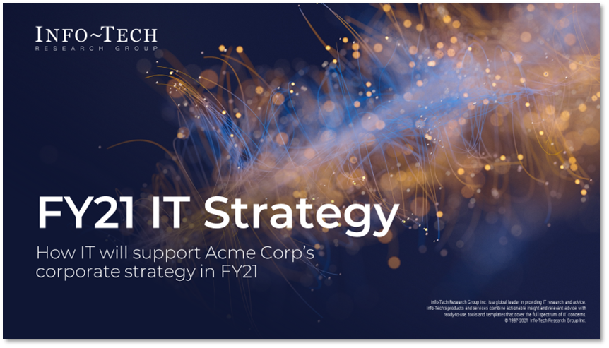
To complete this phase, you will need:
Diagnostic Reports
IT Strategy Presentation Template
Use the Diagnostic Reports as an input for the following activities:
IT Success Stories
Other Diagnostics Data (optional)
Use the IT Strategy Presentation Template to document the results from the following activities:
Business Value Realized
IT Success Stories
Additional Year-In-Review Data

Slide 36
Business value realized must be IT’s primary success factor for the year-in-review
2.1 Business Value Realized
It is important to show how IT contributed to the growth and success of the business over the last fiscal year. Gauge this value by identifying business goals from the previous fiscal year and the specific IT projects or initiatives that enabled each goal.
Business value defines the success criteria of an organization and is interpreted from four perspectives:
Profit generation: The revenue generated from a business capability with a product that is enabled with modern technologies.
Cost reduction: The cost reduction when performing business capabilities with a product that is enabled with modern technologies.
Service enablement: The productivity and efficiency gains of internal business operations from products and capabilities enhanced with modern technologies.
Customer and market reach: The improved reach and insights of the business in existing or new markets.
Business Value Matrix
Outward
Customer and market
reach
Profit generation
Improved capabilities
Financial benefit
Service enablement
Cost reduction
Inward

Slide 37
2.1 Determine business value realized from last fiscal year
2.1 Business Value Realized
Objective: Remind and reflect on what the team has been through over the last year and create a collective experience.
60 minutes
Step 1:
Prepare by rolling out a long piece of paper (5-10 yards) on the floor or on a wall. Draw a timeline representing the period of the last fiscal year. Include dates and a few key events, but not more.
Have participants place sticky notes in spots to describe their milestones or experiences.
Step 2:
Ask participants to draw in elements of their experiences. They can include their highlights and lowlights of the journey as well as insights, emotional highs and lows, challenges, successes, frustrations, stories and surprises, situations, learnings, and anything else that meant something. Reflect back on the business value matrix and brainstorm specific milestones that supported the business.
Give enough time that the paper becomes as full as possible (about 15-30 minutes, depending on the size of the group and length of the timeline).
Step 3:
After the map has been created, ask participants to walk around the map, reflecting in silence on the experiences they have shared. Ask them to begin thinking about the most important moments for them, individually. Give about five to ten minutes for this step.
Step 4:
Finally, get specific. As a group, identify and summarize the following on the map:
Specific business goals achieved by the experiences shared
IT goals and key accomplishments
IT projects/initiatives
Start and end dates for each initiative
Step 5:
Consider an alignment exercise based on where the sticky notes are placed on the timeline:
Business Goals > IT Projects/Initiatives
IT Goals > IT Projects/Initiatives
Document your final and agreed upon business value realized information in your IT Strategy Presentation Template under section 4.
Source: Hyper Island Toolbox

Slide 38
2.1 Determine business value realized from last fiscal year
2.1 Business Value Realized
Input | Output
Business strategy document from previous fiscal IT projects/initiatives from previous fiscal | Business value realized IT’s success in previous fiscal
Materials | Participants
Multicolored markers Roll of paper Collaboration/brainstorming tool (whiteboard, flip chart, digital equivalent) | CIO Senior IT Team
Tips for Online Facilitation
Pick an online whiteboard tool that allows you to use a large, zoomable canvas.
Draw the timeline in the online whiteboard and invite participants to add to it throughout the exercise.
Instead of placing a physical sticky note, have your team place a symbolic image or company logo while sharing. A GIF or meme might also work. If you’re using an online whiteboard tool such as Mural, you can use voting features such as Mural’s voting session tool when voting during the final step.
If you’re not using an online whiteboard, we’d recommend using a collaboration tool such as Google Docs to collect the information for each step under a separate heading. Invite everyone into the document to share their ideas but be very clear in regard to editing rights.
When facilitating group discussion, we recommend participants use non-verbal means to indicate they’d like to speak. You can use tools like Teams’ raise hand tool, a reaction emoji, or just have people put their hands up. The facilitator can then invite that person to talk.
Download the IT Strategy Presentation Template and document your business value realized in section 4.

Slide 39
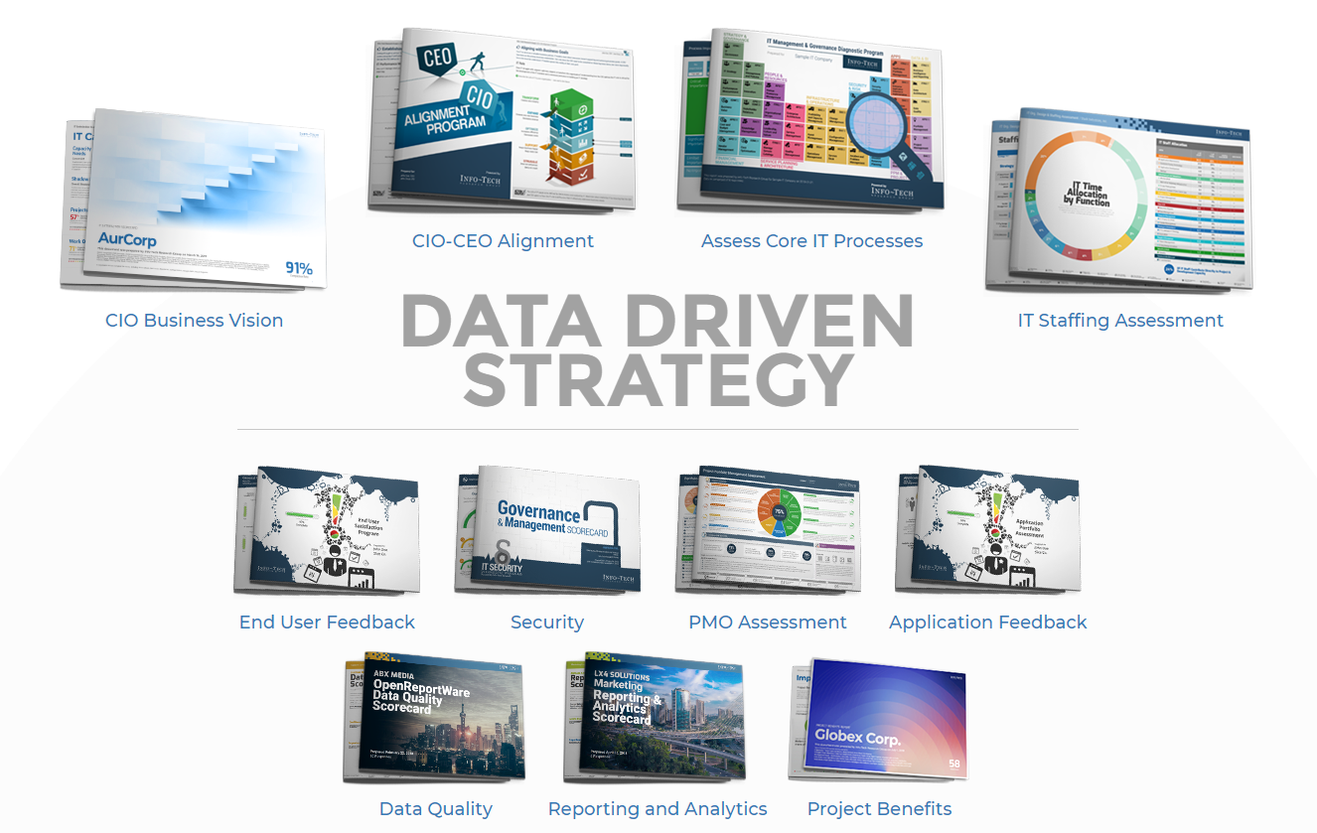
Diagnostic data is the key to building a data-driven strategy
2.2 Diagnostic Data Analysis
A retrospective measure of business value realized from last fiscal year’s strategy and initiatives. Focus on IT’s successes and improvements made and communicate them back to the business.
A current-state analysis to make data-driven decisions on what matters most for the upcoming strategy.

Slide 40
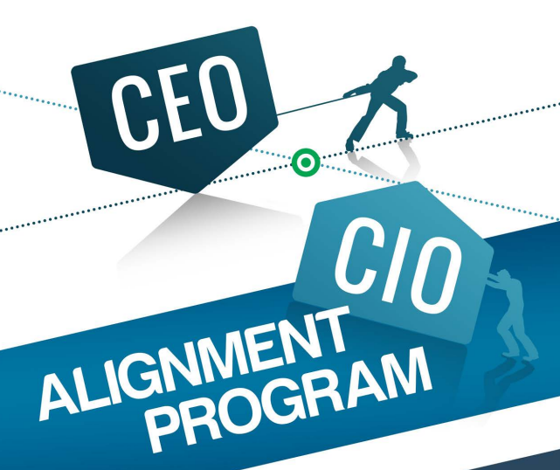
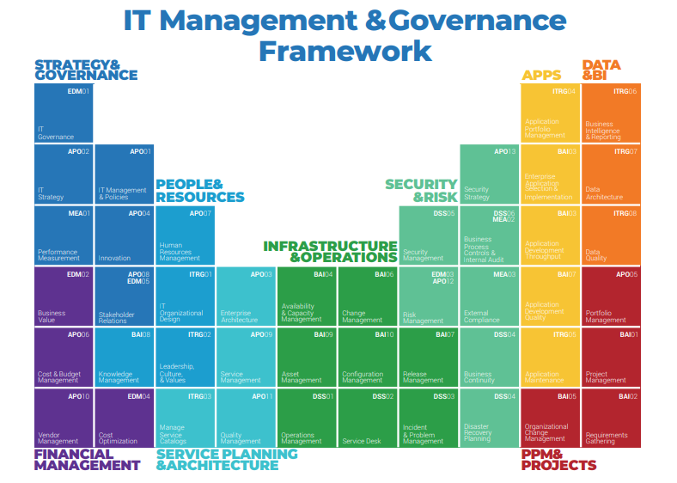

This section focuses on eliciting valuable information from three major diagnostics
2.2 Diagnostic Data Analysis
CEO-CIO Alignment
Audience: CEO
Establishing an alignment between the CEO and CIO means IT stays on track with the CEO’s vision for the future of your business.
Satisfy your most important stakeholder – the CEO.
Business Vision
Management & Governance
The most important thing a CIO can do is understand the business' needs and actively measure that the business is satisfied.
Audience: IT Team
Improving your processes means that you spend less time fighting fires and more time delivering exceptional business value.
Audience: Business Unit Leaders
Measuring the business’ satisfaction with IT’s services means you can use these insights to understand your key business stakeholders, find out what is important to them, and improve your interactions with them.
The overall success of an IT department will depend on the strength of its underlying core processes.

Slide 41
Bookend diagnostic launches to a fiscal year to measure and evaluate the impact of IT strategic initiatives
2.2 Diagnostic Data Analysis
Launch Diagnostics
Launch Diagnostics
Build Strategy
Reflect on Action Plans & Integrate Into Strategy
Be Transparent & Identify Challenges
Highlight Success Stories
Collecting and evaluating stakeholder feedback before building your strategy for the year ensures you are aligning to the organization’s top priorities and pain points and working on what matters most.
Communicate the aggregate diagnostic data as the rationale for why your strategic plan includes certain initiatives and it will propel the business forward.
Any deltas in diagnostic data will be beneficial in communicating the success of your strategic efforts and the impact IT has had on stakeholders and the organization in the span of one year.
Click here to learn more about our diagnostics program

Slide 42
The CEO-CIO diagnostic helps align IT’s future with the business
2.2 Diagnostic Data Analysis
Alignment has been a buzzword for decades. Among CIOs, alignment is hyped as the apex of effective IT and written off as jargon. Yet without the proper tools, CIOs are left to play a guessing game of what deliverables the business demands.
The CEO-CIO program will help you:
Understand the CEO's perception of and vision for IT in your business.
Identify and build core IT processes that automate IT-business alignment.
Create a plan to address alignment gaps impeding business growth.
Deliver your plan to demonstrate IT value and progress.
Instead of producing an endless list to add to your backlog, the program brings clarity to what IT priorities need to be, how they are defined, and how their success is measured. It creates a tangible path to alignment and all of its associated benefits.
Research reveals that companies with robust IT departments effectively aligned to business goals achieve higher growth compared to IT departments lacking alignment. For CIOs, effective alignment can be the tipping point in moving IT from supporting the business to enabling and transforming it.

Slide 43
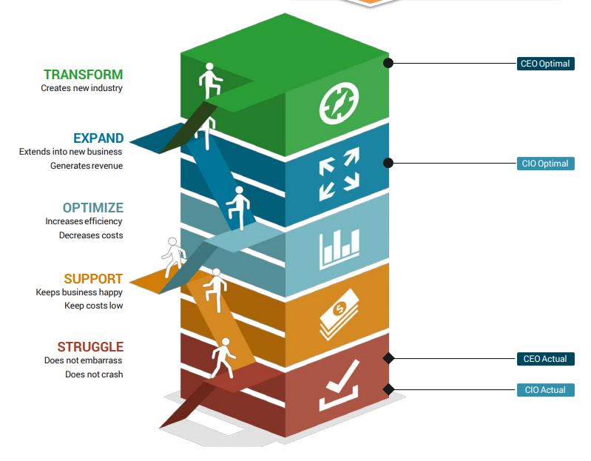
Here are some critical insights to extract from the CEO-CIO report
2.2 Diagnostic Data Analysis
Begin with understanding the role of IT at your organization and calculate the differential between actual and optimal:
For IT to serve as a valuable business partner, IT leaders must direct resources toward supporting and achieving business goals. A CEO functions as the primary business stakeholder. Not only does the CEO need to be consulted on these big-ticket items, but more importantly they must be understood. IT leaders ignore this reality at their own peril.
Pay close attention to both the actual and optimal state to clarify IT’s mandate and current performance.
The optimal state determines IT’s mandate. If the data shows that the two stakeholders are striving towards different target states, IT’s mandate is unclear, and the strategy starts off with misalignment.
Consider communicating these insights
Last Fiscal Year Strategy
Upcoming Year Strategy
The actual state determines IT’s current performance, which is very telling of where IT is struggling to satisfy the business and how effectively IT can address these business needs to arrive at the optimal state.
Has IT moved the needle on its mandate from the previous launch of the diagnostic? Communicate this.
Does a misalignment exist between the CIO’s and the CEO’s perception of IT’s mandate?
Optimal
Has there been any improvement in IT maturity since the previous diagnostic launch? Communicate this.
Does IT’s current performance trigger any projects or initiatives for the upcoming year? Incorporate into strategy.
Actual

Slide 44
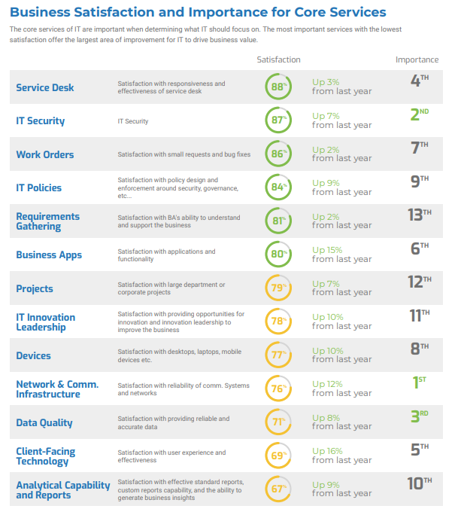
Enabling the business and satisfying stakeholders is THE mission of the IT department. The purpose of the annual Business Vision report is to collect and present stakeholder feedback.
2.2 Diagnostic Data Analysis
Highlight any deltas that communicate improvements in the last fiscal year.
Measuring importance and satisfaction data for core services enables priorities for the team based on what business departments and leaders expect. Once again, alignment is the key.
Consider communicating these insights
Last Fiscal Year Strategy
Upcoming Year Strategy
Consider strategic planning for any services that still require improvements.
Has IT managed to improve any core services that were high importance and low satisfaction? Communicate these.
Do specific core services trigger projects or initiatives for the upcoming year? Incorporate into strategy.
Core Services

Slide 45
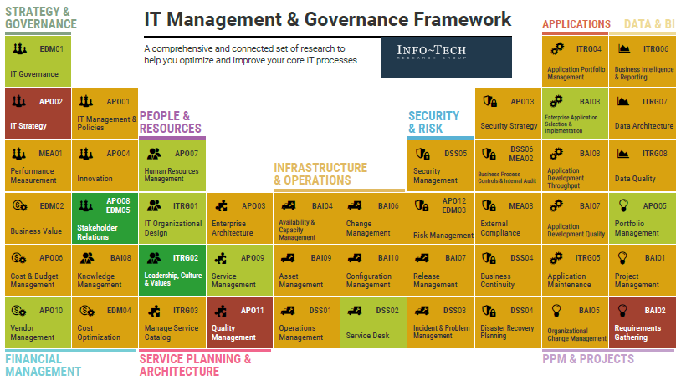
The Management & Governance diagnostic highlights IT’s operational excellence
2.2 Diagnostic Data Analysis
Compare the current MGD report to the one from one year ago and highlight any processes that have improved in maturity. These directly correlate to IT’s operational excellence.
Consider communicating these insights:
Last Fiscal Year Strategy
Upcoming Year Strategy
Has IT managed to improve any core IT processes that were high importance and low effectiveness? Communicate these.
Do specific core processes trigger projects or initiatives for the upcoming year? Incorporate into strategy.
Core IT Processes
Low-performing IT processes must result in an initiative for the upcoming year.

Slide 46
2.2 Evaluate diagnostic data, establish differentials, and uncover success stories
2.2 Diagnostic Data Analysis
Input | Output
CEO-CIO Alignment data Business Vision data MGD data | Success stories from last fiscal Important data visuals to communicate
Materials | Participants
Whiteboards (virtual or physical) or poster boards Collaboration/brainstorming tool (whiteboard, flip chart, digital equivalent) | CIO Senior IT Team
Objective: Conduct a whiteboard rotation to add ideas freely and encourage collaborative storytelling of IT’s success stories.
60 minutes
Establish digital whiteboards for as many diagnostic reports as needed. Post key data visuals from each diagnostic report that can be used to interpret results. Give participants whiteboard URLs, instructions, and other logistics.
Participants visit each whiteboard to contribute assigned information: insights, opinions, differentials in data, etc. Recommendation: Assign a specific amount of time for the entire session, giving average times for each whiteboard, or create an announcement when participants must move on.
Regroup as a larger group and discuss the following specifics to document:
Success stories from last fiscal year
Challenges successfully addressed and deltas in data
Reflections on action plans and strategic initiatives
Things to incorporate into the strategy for the upcoming year
Other insights from the data that are worth highlighting for IT’s success
Evaluate which of these findings and analysis will be beneficial to highlight in the year-in-review section of your strategy and communicate IT’s performance and successes.
Document your final and agreed upon outputs in your IT Strategy Presentation Template under section 4.
Download the IT Strategy Presentation Template and document your success stories in section 4.
Source: Knowmium, 2020

Slide 47
Additional data for year-in-review
2.3 Additional Year-in-Review Data
Assessing diagnostic data is a great starting point to review IT performance over the last fiscal year. However, there maybe additional data that is worth analyzing to further highlight success stories and IT’s strategic efforts.
01
02
03
04
METRICS
MAJOR INITIATIVES
BUDGET
OTHER DIAGNOSTICS (IF APPLICABLE)
Highlight KPIs, targets, and performance from last fiscal year.
Communicate the value realized from IT completing major initiatives.
Evaluate budget details to uncover cost savings and revenue generators.
Based on major pain points from last year, launch additional diagnostics that can help communicate IT’s progress.

Slide 48
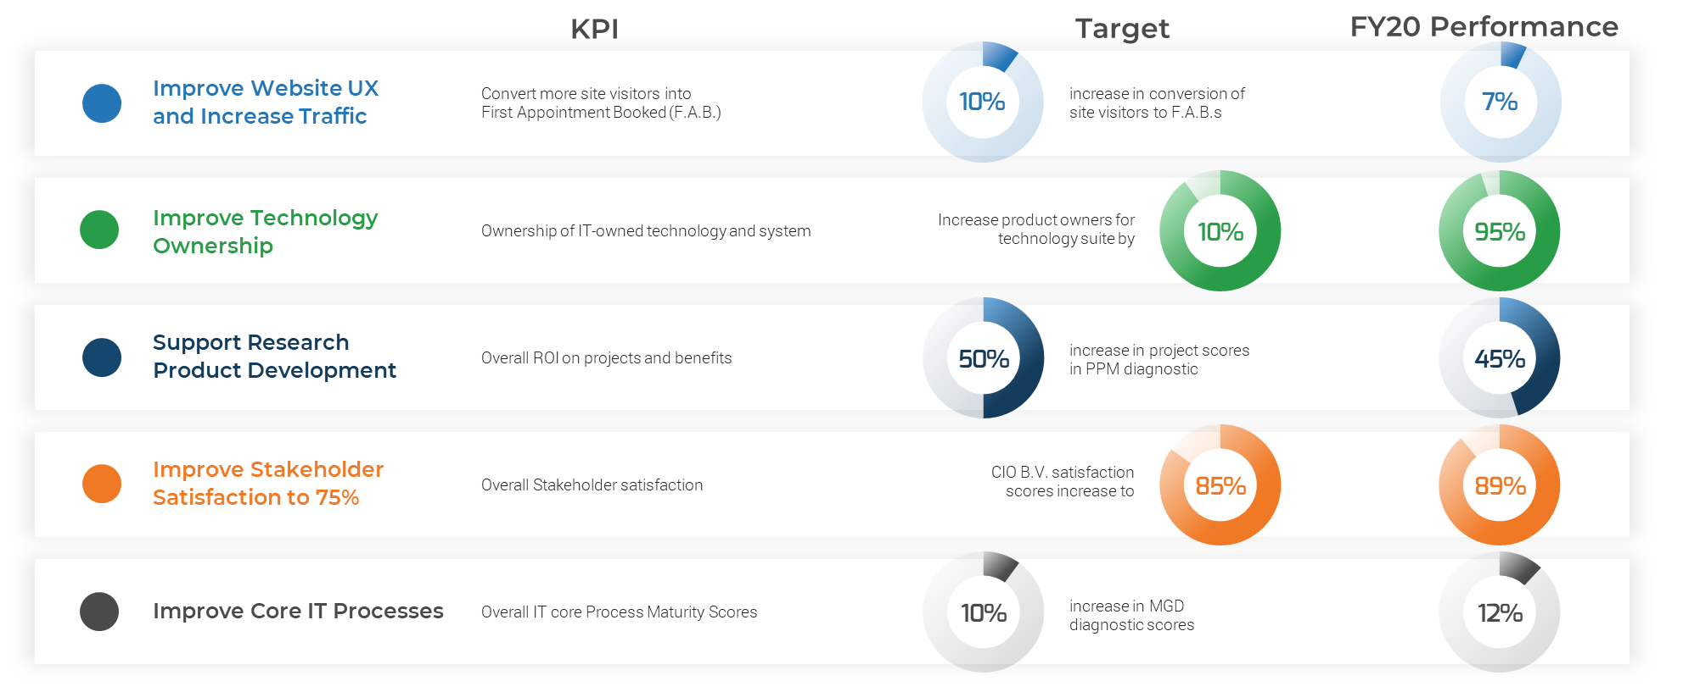
Metrics are critical to ensuring alignment of IT performance and business service value achievement
2.3 Additional Year-in-Review Data
01
METRICS
Focus on communicating business benefits
when targets are achieved instead of IT benefits.
When reviewing performance from the last fiscal year, consider highlighting the following:
KPIs that directly align to IT and business goals that would’ve been featured in last year’s IT strategy document.
Targets that were set out for the team to ensure the success of each IT goal.
The actual performance of the IT team against the targets that were set.
Any differentials worth highlighting where IT surpassed targets and contributed to the overall success of the organization.

Slide 49
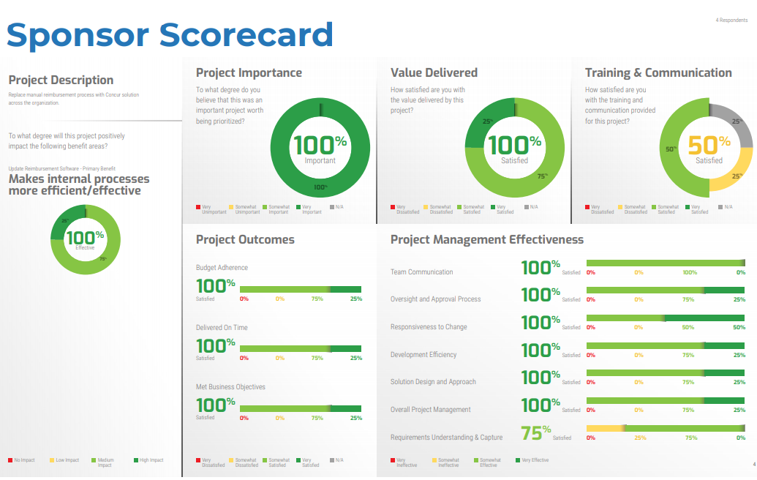
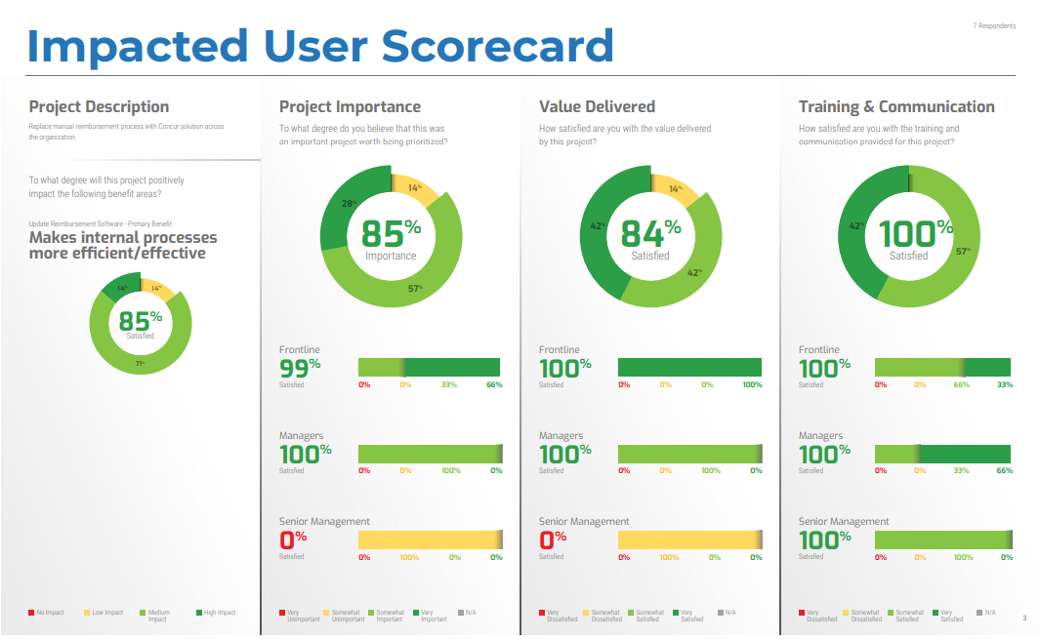
Communicate project impact from the perspective of sponsors and impacted users
2.3 Additional Year-in-Review Data
02
MAJOR INITIATIVES
This diagnostic performs a 180-degree assessment of a project’s impact. Present this diagnostic on a separate slide in your IT strategy.
If the diagnostic is not performed, then highlight the measured achievement of the original targets of the project or a measure of the business sponsor satisfaction from the project.
Although KPIs and metrics are an effective measure of IT’s success, communicating the satisfaction of major initiatives from the POV of project sponsors and impacted users can augment the story told about benefits realization. Consider eliciting the following information about major projects:
Project description, objectives, and predicted outcomes
Target statements to describe each predicted outcome and whether that value was realized
Sponsor and impacted-user feedback and assessments on project importance, value delivered, training and communication, etc.
The goal here is to craft the communication around project/initiative impact from the perspective of business sponsors and end users who can advocate for IT’s contribution to the organization.
Visit the My Project Dashboard to get started on using scorecards.

Slide 50
2.3 Additional Year-in-Review Data
03
Categorize your budget three ways to highlight IT spending
BUDGET
Budget to Support Major Business Initiatives
1
Business Support
This is likely the largest portion of IT’s budget given most strategic initiatives must align back to the business strategy.
+
IT Budget
Budget to Reduce Risk and Improve IT Operational Excellence
2
IT Excellence
This portion of your budget must include spending to “keep the lights on” while targeting any additional operational excellence initiatives to improve the products and services IT offers.
Your budget must collectively support the business goals and corporate initiatives and improve the delivery of IT services.
+
Budget to Drive Technology Innovation
3
Innovation
Ensure IT is always highlighting innovation as a key budget line item. This improves trust with the business that organizational enablement is IT’s #1 goal.

Slide 51
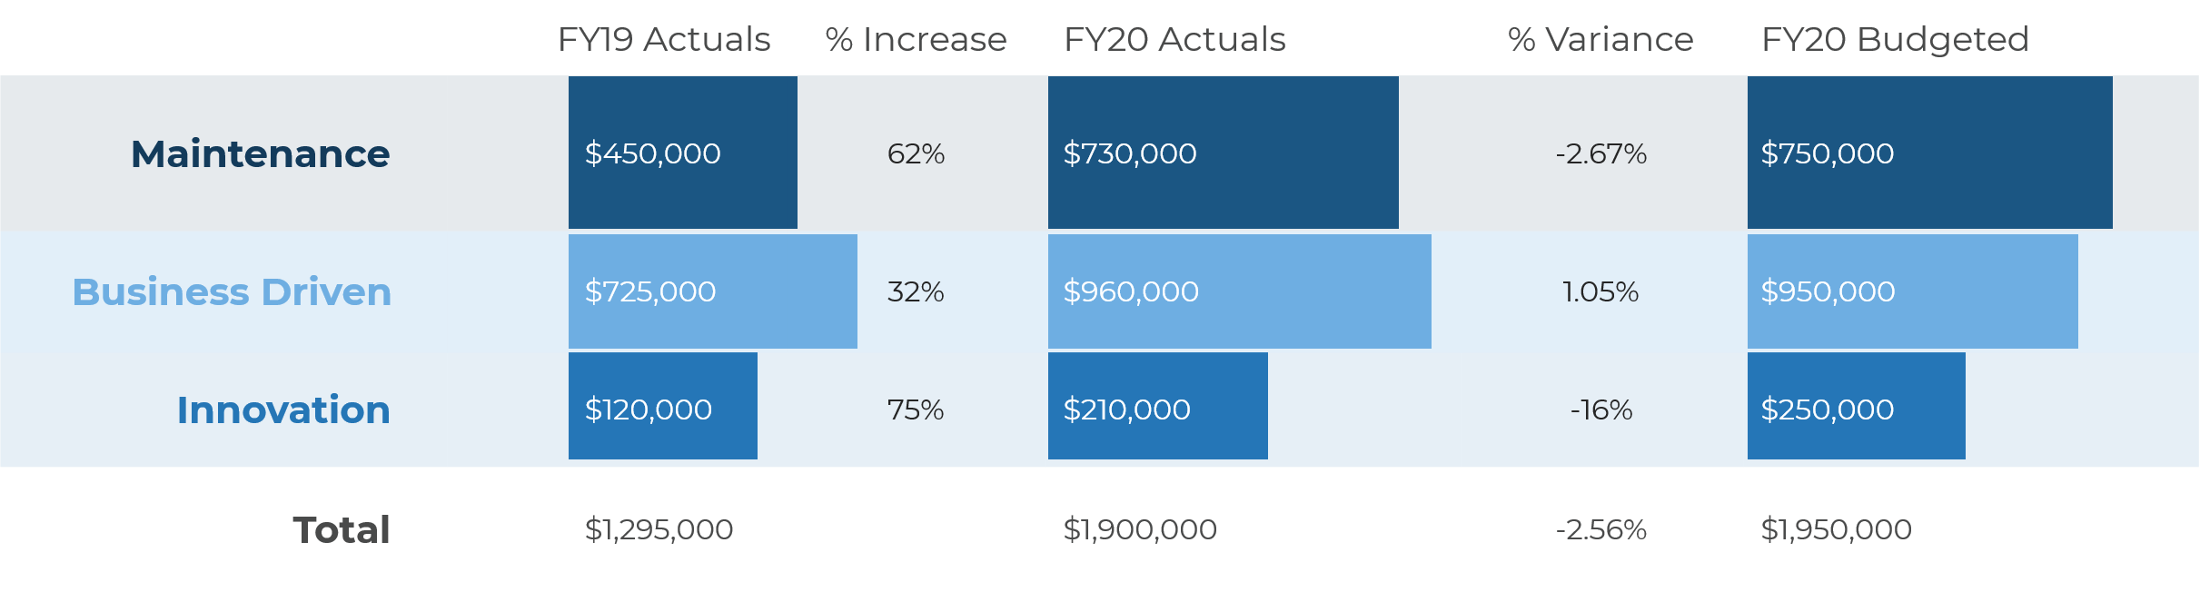
Business stakeholders care whether IT can complete projects on time and on budget
2.3 Additional Year-in-Review Data
03
BUDGET
It is important to communicate IT’s success within the parameters set out for the strategic year. This include the timeline and budget within which IT promised to deliver.
Communicating a succinct story around budget will require financial data from the past two fiscal years:
Budgeted amount for the past fiscal year
Actuals from the past two fiscal years
Financials categorized by the type of initiative it supports (business support, IT excellence, innovation)
The goal is to communicate that IT kept the budget within X% +/- for the fiscal year. This is important when making the budget request for the upcoming strategic year and gives IT credibility with business stakeholders and/or the board.
The comparison of actuals from the past two fiscal years should validate IT’s ask for any budget increases.
The variance in budgeted vs. actuals ideally will communicate that IT is cost conscious.

Slide 52
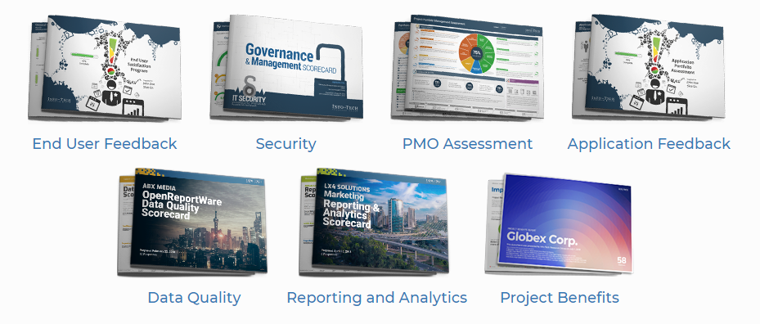
Communicate any major pain points resolved with further stakeholder feedback
2.3 Additional Year-in-Review Data
04
OTHER DIAGNOSTICS
Collect the data you need to effectively manage IT security and measure stakeholder confidence and satisfaction with any strategic initiatives to do so.
If project and portfolio processes were labeled low maturity, collect the data you need to understand and optimize your PPM practices.
Making technology enhancements is part of any strategic plan. Find out what users really think of IT’s business applications that were high priority in the last fiscal year.
Find out what users really think of IT services and measure any improvements in satisfaction with IT.
The Project Dashboard enables you to collect feedback to ensure your key projects are on track and to measure and communicate success. Refer to this tool when communicating the success of all major strategic initiatives/projects.
Business leaders need reliable and effective data to deliver results. Measure whether IT is effectively enabling it.
Get a report showing the business' most-pressing reporting and analytics needs so you can focus your improvement efforts to meet their needs and highlight any problem areas solved in the last fiscal year.

Slide 53
2.3 Compile and prioritize additional year-in-review data
2.3 Additional Year-in-Review Data
Objective: Use dot voting to obtain consensus on decisions and/or data, by ranking a list of IT success stories to communicate in your strategy.
Input | Output
Metrics, KPI, targets Major initiatives summaries Financials Optional diagnostic reports | Success stories from last fiscal Important data visuals to communicate
Materials | Participants
Collaboration/ brainstorming tool (whiteboard, flip chart, digital equivalent) Sticky dots | CIO Senior IT Team
60 minutes
Split into small groups and review all additional year-in-review data.
Identify the following:
Success stories from last fiscal year
Challenges successfully addressed and deltas in data
Reflections on action plans and strategic initiatives
Things to incorporate into strategy for upcoming year
Other insights from the data that are worth highlighting for IT’s success
Regroup as a larger group and share your findings and perspectives. Document one success story per sheet of paper and add it to the whiteboard.
After creating a number of scenarios around success stories, provide each participant with a number of voting dots. Three to five dots is usually sufficient.
Instruct each participant to use their dots to vote for the success stories most important to them. Participants can spread dots amongst multiple topics or put all dots on one topic.
Tally up results to help guide and prioritize future discussion.
Evaluate which of these findings and analyses will be beneficial to highlight in the year-in-review section of your strategy and communicate IT’s performance and successes.
Document your final and agreed upon outputs in your IT Strategy Presentation Template under section 4.
Download the IT Strategy Presentation Template and document your year-in-review data in section 4.

Slide 54
2.4 Finalize your year-in-review
2.4 Year-in-Review Completion
Your year-in-review section of the IT strategy deliverable helps communicate the value realized and the operational performance of your team.
Why is this important?
A retrospective approach to your team’s performance helps communicate the impact that IT has had toward the success of the organization.
It empowers your team and celebrates the value delivered by IT thus far.
It sets the course for the upcoming strategy by highlighting what your team is capable of.
It builds credibility with business stakeholders by showcasing how IT can be a strategic business partner.
Budget Adherence Information
IT Goal-Specific Metrics & Measurements
Stakeholder Feedback & Diagnostic Data Analysis
Benefits & Value Realization
Year-in-Review Section of IT Strategy Deliverable
Input information into the IT Strategy Presentation Template

Slide 55
Review performance from last fiscal year
Analyzed and communicated the benefits and value realized from IT’s strategic initiatives in the past fiscal year.
Analyzed and prioritized diagnostic data insights to communicate IT success stories.
Elicited important retrospective information such as KPIs, financials, etc. to build IT’s credibility as a strategic business partner.

Slide 56
Phase 3
This phase will walk you through the following activities:
Elicit business context from the CIO & IT team
Identify key initiatives that support the business
Identify key initiatives that enable IT excellence
Identify initiatives that drive technology innovation
Build initiative profiles
Construct your strategy roadmap
This phase involves the following participants:
CIO
Senior IT Team
Build Your Key Initiative Plan
Phase 1
Phase 2
Phase 3
Build a Business-Aligned IT Strategy
3.1 Elicit Business Context
3.2 Identify Key Initiatives
3.3 Build Initiative Profiles
3.4 Construct Strategy Roadmap
Phase 4

Slide 57
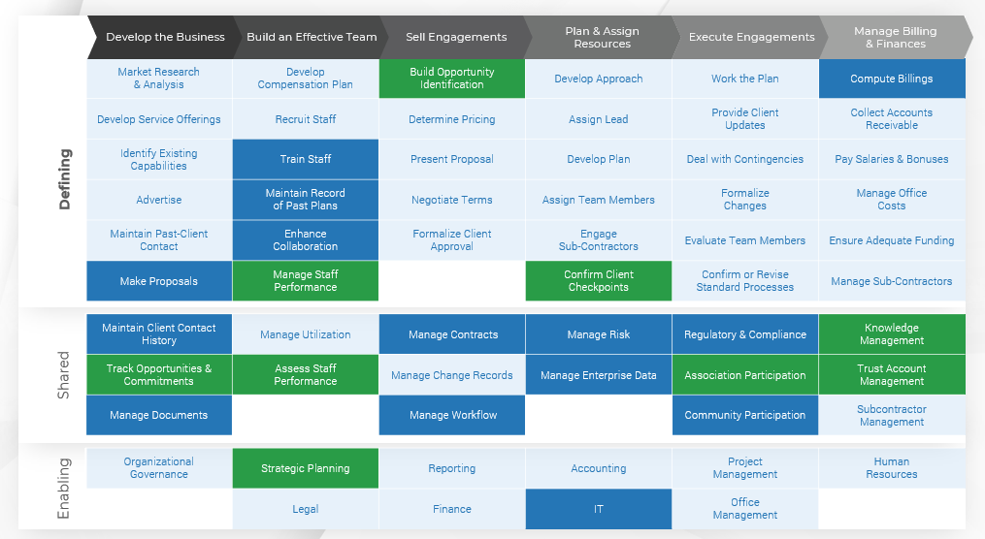
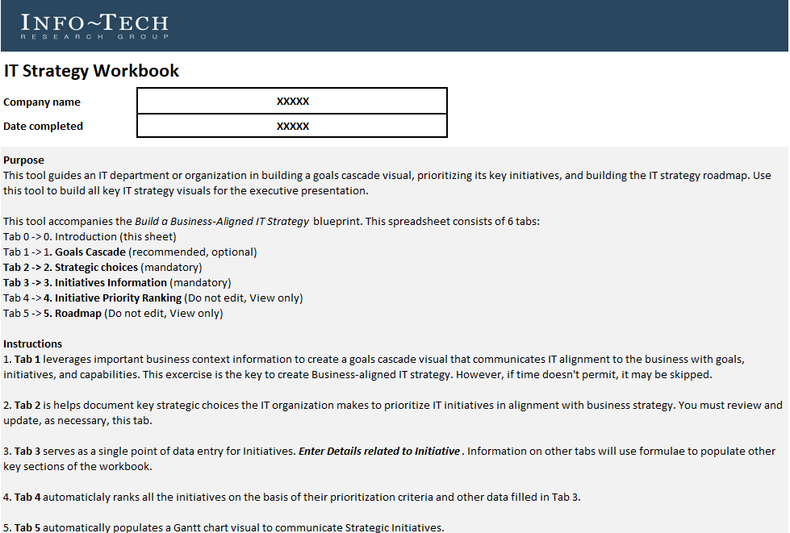
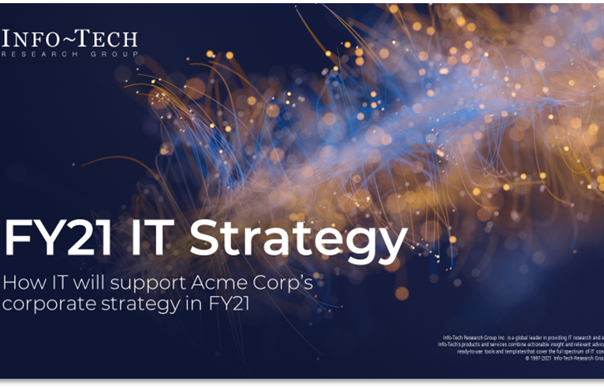
To complete this phase, you will need:
Business Context Information
IT Strategy Workbook
IT Strategy Presentation
Use the business context information as an input for the following activities:
Elicit Business Support Initiatives
Goals Cascade
Use the IT Strategy Workbook to document the results from the following activities:
Goals Cascade
Key Initiative Prioritization
Strategy Roadmap
Use the IT Strategy Presentation Template to document the results from the following activities:
Build Initiative Profiles
Build Initiative Profiles
Strategy Roadmap

Slide 58
Understanding the business context is a must for all strategic initiatives
3.1 Elicit Business Context
CIOs must execute strategic initiatives to add value to the business. Most CIOs fail because of low support from the business.
IT is no longer seen as a support function. It is a key driver of the business and brings to the table new business expansion opportunities leveraging emerging technologies.
As a strategic driver, IT needs to work with the business. Yet traditionally IT has not worked hand in hand with the business. IT does not know what information it needs from the business to execute on its initiatives.
A faster time to new investment decisions means that IT needs a repeatable and efficient process to understand what the business needs.
At its core, each strategic IT project requires answers to a specific set of questions regarding the business.
An effective CIO understands how to support the business’ strategic initiatives and how to significantly improve enterprise productivity. To understand the business context, the CIO needs to ask pointed questions to uncover business imperatives.
What Is Business Context?
“The business context encompasses an understanding of the factors impacting the business from various perspectives, including how decisions are made and what the business is ultimately trying to achieve. The business context is used by IT to identify key implications for the execution of its strategic initiatives.”
Source: Business Wire, 2018

Slide 59
IT departments that understand business needs provide more value
3.1 Elicit Business Context
IT departments that understand the business context provide greater value, as shown by the strong positive relationship between IT’s understanding of business needs and the business’ perception of IT value.
This data shows that organizations who feel IT understands their needs are also providing more value to the business. The positive correlation shows that the more IT understands what the business wants, the higher value they can provide. Therefore, understanding needs through eliciting the business context can ensure IT achieves higher satisfaction with the business and provides more value through greater alignment.
The correlation between understanding of needs and IT value is r=0.89
Source: Info-Tech Research Group diagnostic data

Slide 60
Conduct interviews to elicit the business context
3.1 Elicit Business Context
Stakeholder Interviews
Your organization’s top 3 business goals
1
Begin by conducting interviews of your executive team. Interview the following leaders:
Chief Information Officer
Chief Executive Officer
Chief Financial Officer
Chief Revenue Officer/Sales Leader
Chief Operating Officer/Supply Chain & Logistics Leader
Chief Technology Officer/Chief Product Officer
INTERVIEWS MUST UNCOVER
2
Your organization’s top 10 business initiatives
3
Your organization’s mission & vision

Slide 61
The CIO elicits the business context through interviews with their business counterparts
3.1 Elicit Business Context
A prerequisite to all strategic planning should be to elicit the business context from your business stakeholders. At a basic level, the CIO understands what questions to ask to understand the general business context. At a more advanced level, the CIO can discern which questions they need answers to for each key IT initiative and what those answers need to look like to be sufficient for execution. Consider the following questions to elicit the business context and uncover the right information to build your strategy:
Question | Document(s)/Method | Key Findings (Examples)
What is the mission of the organization? | Website Strategy document | Mission: Help our clients create long-lasting improvements by delivering exceptional service and products
What are your targets for the organization? | CEO interview | Reduce manufacturing operating costs by 10% Improve top-of-mind brand awareness by 15%
What are the organization’s strategic investment goals? | CFO interview Digital strategy | Geographic expansion List of digital investments
What are the goals of the organization over the next 12 months? | Strategy document Corporate retreat notes | Hire 100 new sales reps Improve product management and marketing
What are your top business initiatives over the next 12 months? | Strategy document CEO interview | Invest in sales team development Expand the product innovation team
How do your top business initiatives support your business goals? | Strategy document CEO interview | Unprecedented client value through product innovation Acquire new accounts to build market footprint
Note: This is a prerequisite to building your IT strategy.
Visit Info-Tech’s business context blueprint to download the full methodology.

Slide 62
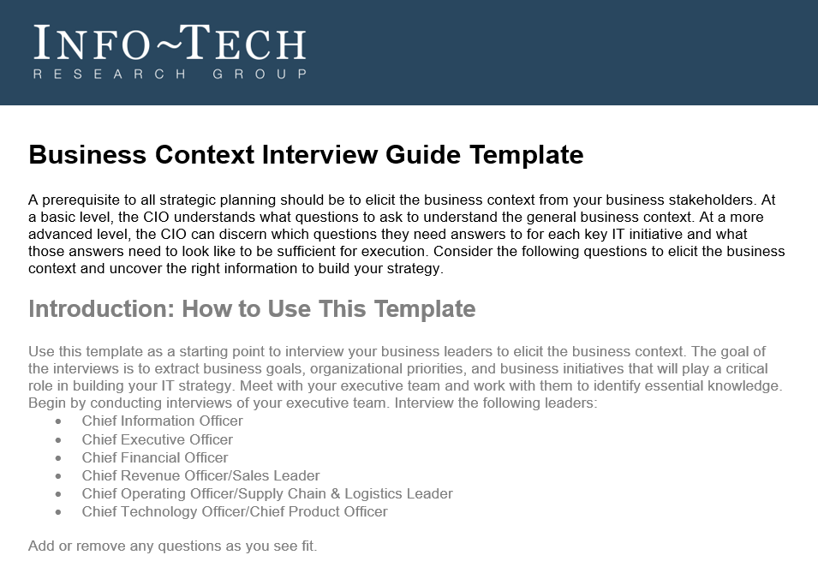
Use Info-Tech’s executive interview guide to elicit the business context
3.1 Elicit Business Context
Use the business context interview guide to customize interview questions and document answers from your business leaders. There are three key outcomes you should be looking for from your interviews. Leverage the prepopulated questions in the guide to get started, but ensure you tailor your questions (if required) to uncover the following information:
Your organization’s top 3 business goals
Your organization’s top 10 business initiatives
Your organization’s mission and vision
Download the Business Context Interview Guide

Slide 63
3.1 Elicit and document the business context and business goals
3.1 Elicit Business Context
Input | Output
Reference architecture (including industry capability map) Business strategy document | Completed interviews with executive team Business goals, business initiatives, and business capabilities sections of goals cascade
Materials | Participants
Collaboration/ brainstorming tool (whiteboard, flip chart, digital equivalent) Interview guide | CIO Senior IT Team
Objective: Elicit the business context with careful review of all business and strategy documents.
5 hours
Gather the IT strategy creation team and revisit your business strategy document and list of interview candidates.
As the CIO, conduct a maximum of five interviews with your business leaders/executive team members, starting with your boss (CEO).
Discuss the questions in the interview guide with participants and document key findings in the Business Context Interview Guide.
Analyze the responses and prioritize the business goals and business initiatives that IT needs to address or start addressing within the next 12 months.
Discuss findings with your IT strategy creation team and link the prioritized business initiatives to the key business capabilities that need to be created or improved.
Download the Business Context Interview Guide to document your findings

Slide 64
A goals cascade will strengthen IT’s alignment with the business goals
3.1 Elicit Business Context
The cascade reveals business goals, streamlines the definition of IT priorities and processes necessary to achieve business goals, and identifies pain points that impede IT effectiveness. Keep in mind that goals and their respective importance will change over time. Revisit and refine the cascade annually.
Business Goals
Business Initiatives
Business Capabilities
Support
Achieved Through
Create or Improve
IT
Capabilities
IT
Initiatives
IT
Goals
Create or Improve
Achieved Through

Slide 65
You can align business goals to capabilities by identifying the value streams they relate to
3.1 Elicit Business Context
Value streams connect business goals to the organization’s value realization activities in the marketplace. Those activities are dependent on the specific industry segment in which an organization operates.
Business Goals
Business Initiatives
Business Capabilities
Understand your industry’s capability map with assistance from our industry analysts.
Achieved Through
Create or Improve
Download Info-Tech’s Industry Capability Maps and schedule a call to get started.

Slide 66
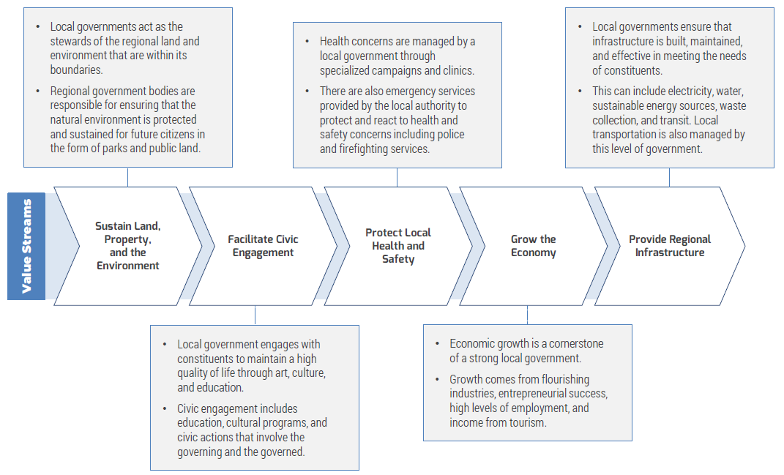
Begin with understanding your industry’s generic value streams
3.1 Elicit Business Context
Value Streams Defined:
Value streams connect business goals to the organization’s value realization activities in the marketplace. Those activities are dependent on the specific industry segment in which an organization operates.
There are two types of value streams: core value streams and support value streams.
Core value streams are mostly externally facing. They deliver value to either an external or internal customer, and they tie to the customer perspective of the strategy map.
Support value streams are internally facing and provide the foundational support for an organization to operate.
An effective method for ensuring all value streams have been considered is to understand that there can be different end-value receivers.
Example Value Streams: Consulting Industry

Slide 67
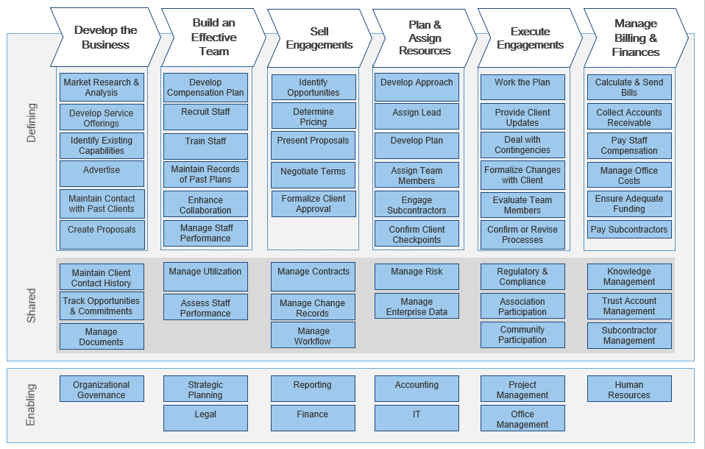
Review the full capability map for your industry
3.1 Elicit Business Context
Business Capability Map Defined
In business architecture, the primary view of an organization is known as a business capability map.
A business capability defines what a business does to enable value creation, rather than how. Business capabilities:
Represent stable business functions.
Are unique and independent of each other.
Typically will have a defined business outcome.
A business capability map provides details that help the business architecture practitioner direct attention to a specific area of the business for further assessment.
Info-Tech Insight
Knowledge of your current situation is only half the battle; knowledge of the business/industry is key.

Slide 68
Understand the implications of business initiatives on business capabilities
3.1 Elicit Business Context
Develop the Business
Build an Effective Team
Sell Engagements
Plan & Assign Resources
Execute Engagements
Manage Billing & Finances
Market Research &
Analysis
Step 1-B: Visual
Develop Compensation Plan
Build Opportunity Identification
Develop Approach
Work the Plan
Compute Billings
Develop Service Offerings
Recruit
Staff
Determine Pricing
Assign Lead
Provide Client
Updates
Collect Accounts Receivable
Defining
Identify Existing Capabilities
Train Staff
Present Proposal
Develop Plan
Deal with Contingencies
Pay Salaries & Bonuses
Advertise
Maintain Record of Past Plans
Negotiate Terms
Assign Team Members
Formalize
Changes
Manage Office
Costs
Maintain Past-Client Contact
Enhance
Collaboration
Formalize Client Approval
Engage Sub-Contractors
Evaluate Team Members
Ensure Adequate Funding
Customize your capability map by identifying supporting and new capabilities to incorporate into your capability map based on their impact on each business initiative.
Map the alignment of new and current capabilities that need improvement back to each business initiative as shown on the right.
Make Proposals
Manage Staff Performance
New capability
Confirm Client Checkpoints
Confirm or Revise Standard Processes
Manage Sub-Contractors
New capability
New capability
Maintain Client Contact History
Manage Utilization
Manage Contracts
Manage Risk
Regulatory & Compliance
Knowledge
Management
Shared
Track Opportunities & Commitments
Assess Staff Performance
Manage Change Records
Manage Enterprise Data
Association Participation
Trust Account Management
Manage
Documents
New capability
Manage Workflow
New capability
Community Participation
Subcontractor Management
Info-Tech Insight
Leave the PESTLE analysis to the business and let go of the SWOT analysis. It’s a new world where capabilities can be acquired as a service.
Organizational
Governance
Strategic
Planning
Reporting
Accounting
Project
Management
Human
Resources
Enabling
Legal
Finance
IT
Office
Management
Legend:
Current Capability
New Capability
Alignment to Business Initiative #1
Alignment to Business Initiative #2

Slide 69
Case Study
3.1 Elicit Business Context
INDUSTRY
COMPANY
Acme Corp. elicited business context to identify the organizational goals and initiatives and to customize its capability map.
Professional Services
Acme Corp.
Business Goals
Business Initiatives
Business Capabilities
Achieved Through
Create or Improve
Acme Corp. Business Goals:
Unprecedented Client Value
Clear Value Proposition
Superior Products and Services
Acme Corp. Business Initiatives:
Launch Industry Specialization
Increase Sales Capacity
Fund Corporate Growth
Acme Corp. Business Capabilities:
Develop the Business
Sell Engagements
Manage Billing and Finances

Slide 70
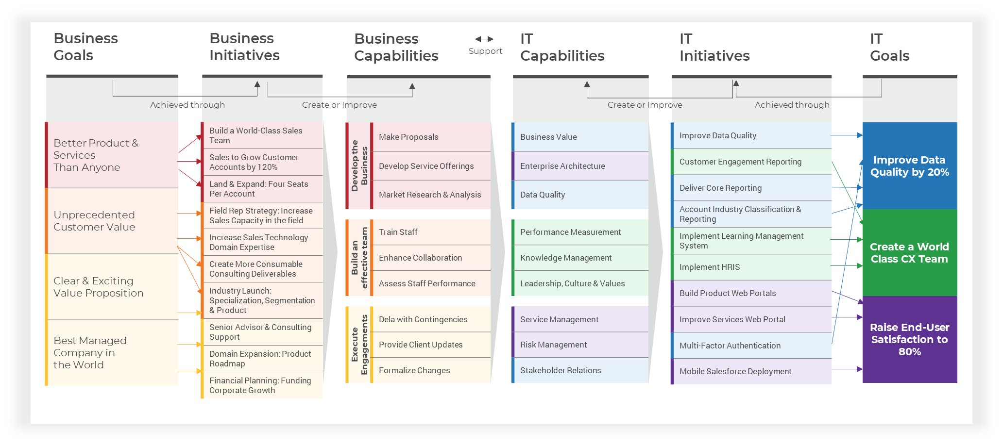

Complete the business section of your goals cascade
3.1 Elicit Business Context
Once you’ve identified your business goals, initiatives, and supporting capabilities, input this key information into your final goals cascade visual for your IT strategy. Remember to use a clear legend and colour coding system to depict the alignment between all three. The remainder of the goals cascade will be completed after your key initiative plan is documented in the next section.
Download the IT Strategy Workbook and document your goals cascade in the “Goals Cascade” Tab.

Slide 71
Key IT strategy initiatives can be categorized in three ways
3.2 Identify Key Initiatives
1
Support Major Business Initiatives
Business Support
Each corporate initiative is supported by a major IT project and each project has unique IT challenges that require IT support.
IT Key Initiative Plan
+
Reduce Risk and Improve IT Operational Excellence
2
IT Excellence
Initiatives collectively support the business goals and corporate initiatives and improve the delivery of IT services.
These projects will increase IT process maturity and will systematically improve IT.
+
3
Drive Technology Innovation
Innovation
These projects will improve future innovation capabilities and decrease risk by increasing technology maturity.
Info-Tech Insight
A CIO has three roles: enable business productivity, run an effective IT shop, and drive technology innovation. Your key initiative plan must reflect these three mandates and how IT strives to fulfill them.

Slide 72
Business support initiatives must be directly aligned to business context outputs
3.2 Identify Key Initiatives
Each corporate initiative is supported by a major IT project, and each project has unique IT challenges that require IT support. Eliciting business support initiatives also requires a closer look at IT’s current maturity and enabling projects.
Support Corporate Projects
1a
A forward-looking approach to supporting the business involves identifying the right capabilities that can underpin the coming year’s corporate projects.
Business Support Initiatives
1
1b
Become a Better Business Partner
A retrospective approach to supporting the business involves a focus on improving IT’s maturity and stakeholder satisfaction as measured over the past year.

Slide 73
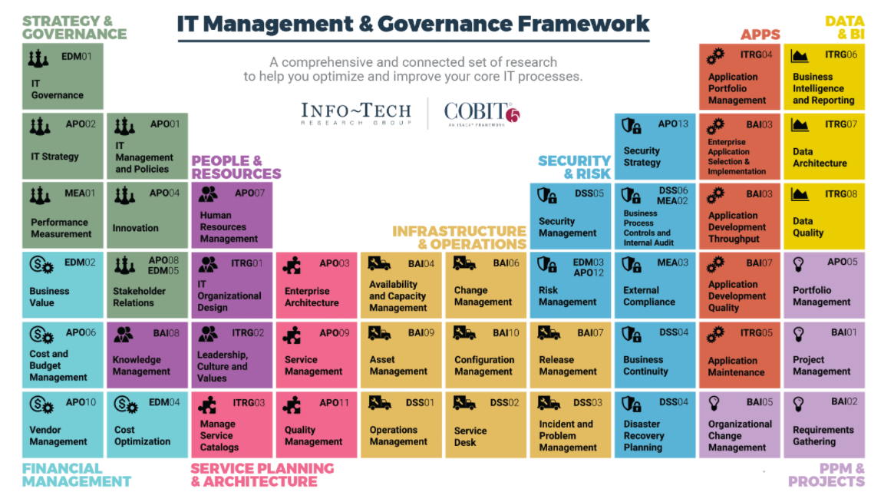
Identify the IT capabilities that directly support each high-priority business capability
3.2 Identify Key Initiatives
1a
Business Capabilities
IT
Capabilities
Support
Revisit the business capabilities on your goals cascade. Identify the IT capabilities that support each business capability. Where is IT contributing effectively today and where does IT see opportunity to do more?
Download Info-Tech’s IT Management & Governance Framework to get started.

Slide 74
Brainstorm IT initiatives to enable high areas of opportunity to support the business
3.2 Identify Key Initiatives
1a
Brainstorm IT initiatives using the framework below for each IT capability that provides a high area of opportunity for IT support.
IT
Capabilities
IT
Initiatives
What processes must be created, changed, or removed to enable this capability?
Process
Technology
Create or Improve
Capabilities are what a business does to enable value creation, rather than how.
Initiatives are projects with a definitive start and end date, and they enhance, create, maintain, or remove capabilities.
What systems are required to enable this capability?
Organization
What initiatives are required to manage people, data, and other organizational factors?

Slide 75
Supporting the business requires a closer look at IT’s current maturity
3.2 Identify Key Initiatives
1b
The optimal state determines IT’s mandate. If the data shows that the two stakeholders are striving towards different target states, IT’s mandate is unclear and the strategy starts off with misalignment.
A retrospective approach to supporting the business involves a focus on improving IT’s maturity and stakeholder satisfaction. Refer back to CEO-CIO Alignment data to identify specific initiatives that will help IT achieve its target state.
Answer these questions to determine initiatives
Upcoming Year Strategy
The actual state determines IT’s current performance, which is very telling of where IT is struggling to satisfy the business and how effectively IT can address these business needs to arrive at the optimal state.
Optimal
Does a misalignment exist between the CIO’s and the CEO’s perception of IT’s mandate?
Does IT’s current performance trigger any projects or initiatives for the upcoming year? Incorporate these into the strategy.
Actual
Source: Info-Tech, Business Vision Diagnostic

Slide 76
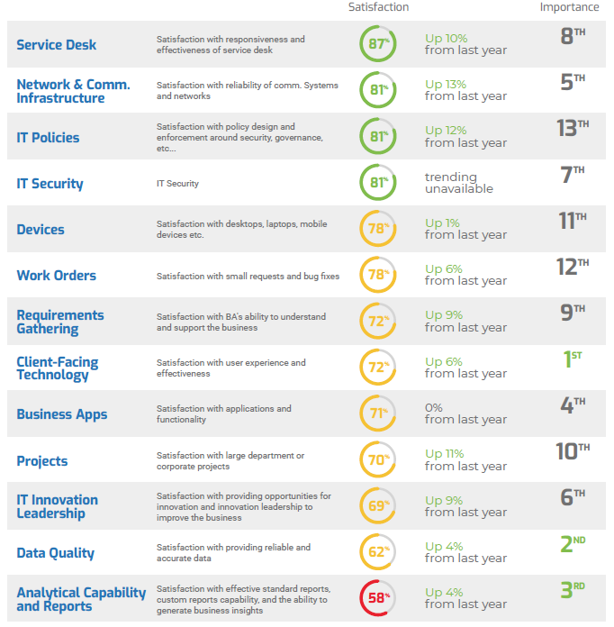
Consider low-performing core services that can also uncover initiatives
3.2 Identify Key Initiatives
1b
High
High Priority | Maintain
Low Priority | Low Priority
Data Quality
Client-Facing Technology
Analytical Capability & Reporting
Plot all core services by their importance and satisfaction data. Low-performing core services are an immediate priority on your key initiative plan.
Importance
Devices
Work Orders
Low
Satisfaction
High
Source: Diagnostic analysis of business satisfaction scores

Slide 77
3.2.2 Brainstorm and document your IT initiatives to support the business
3.2 Identify Key Initiatives
Objective: Leverage breakout discussions to dive into business support initiatives and brainstorm business support initiatives.
60 minutes
Gather the IT strategy creation team and revisit your IT initiatives.
Break into small groups and give each group one value stream. Identify and highlight the high areas of opportunity on the capability map.
Assign an equal number of business goals/initiatives to each smaller group. Groups will be given 30 minutes. Each discussion group will cover a pre-identified business goal/initiative.
Select a note taker and a spokesperson. Groups should be prepared to share answers with the larger group.
Work backward to figure out the necessary actions to achieve the goal and the necessary capabilities to achieve it. Brainstorm process, technology, and organizational initiatives that are required to maintain, create, enhance, or remove specific IT capabilities.
Be succinct. Each initiative should be an actionable statement.
Prioritize the initiatives by considering if the initiative is something you feel will make an impact on the business goal/initiative. Eliminate any initiatives that will not make an impact.
Collect insights over difficulties that might be encountered, steps that need to be taken, and resources needed to achieve the goal.
Note: Goals, capabilities, and initiatives will most likely have a many-to-many relationship at this stage. Ensure your alignment activity provides clarity and insight into why and how you chose business support initiatives for your strategy.
Review the CEO-CIO Alignment and Business Vision reports and identify initiatives based on the following:
IT’s target maturity and initiatives that will help achieve target state
Low-performing core services
Document your findings in the IT Strategy Workbook and build your goals cascade visual.

Slide 78
3.2.2 Brainstorm and document your IT initiatives to support the business (cont.)
Input | Output
Business context (business goals, initiatives, capabilities) IT capability map Diagnostic data | IT initiatives Goals cascade
Materials | Participants
Capability maps Diagnostic reports Collaboration/brainstorming tool (whiteboard, flip chart, digital equivalent) | CIO Senior IT Team
Download the IT Strategy Workbook and document your goals cascade in the “Goals Cascade” Tab.

Slide 79
Case Study
3.2 Identify Key Initiatives
INDUSTRY
COMPANY
Acme Corp. identified eight initiatives to support the business.
Professional Services
Acme Corp.
Enable Corporate Projects
1a
Implement LMS system
Implement HRIS system
Improve web portal for product X
Enable multi-factor authentication
Develop services website portal
Business Support Initiatives
1
1b
Become a Business Partner
Improve alignment and communication between CEO and CIO on target state (achieve target maturity)
Improve data quality (address low-performing service)
Improve capability reporting (address low-performing service)

Slide 80
3.2 Identify Key Initiatives
To reduce risk and improve IT operations, identify the most-important and least-effective processes to evolve
Evolve IT Process Maturity
A current-state analysis approach to improving IT operations involves a focus on identifying the importance and effectiveness of our core IT process in the current state.
2
Low-maturity processes can be evolved with remediation through process, technology, or organizational initiatives.
IT Excellence
Identify low-maturity IT processes
Prioritize based on effectiveness and importance
Formulate IT excellence initiatives

Slide 81
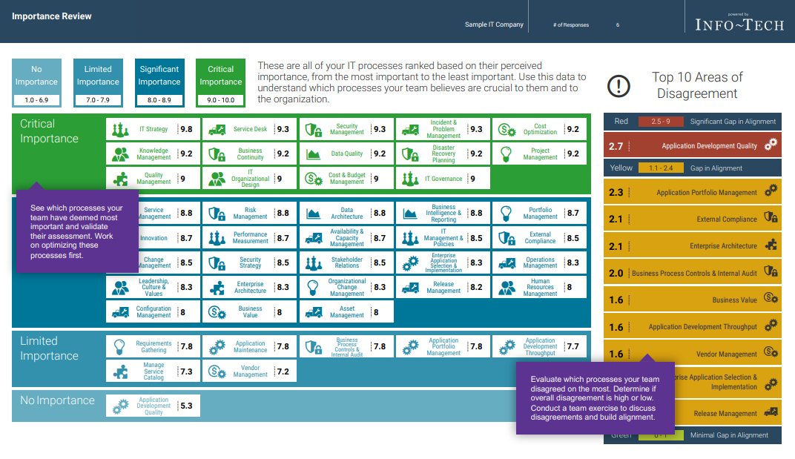
Refer to the Management & Governance diagnostic to identify priority IT processes
3.2 Identify Key Initiatives
Evaluate which processes your team disagreed on the most. Determine if overall disagreement is high or low. Conduct a team exercise to discuss disagreements and build alignment.
Work with your team to ensure processes have clear ownership and accountability is reasonably distributed across your team.
See individual respondent scores for each process as well as their involvement. Use this to facilitate a conversation with the team and build consensus around performance and the priority level of each process.
Source: Info-Tech, Management & Governance Diagnostic

Slide 82
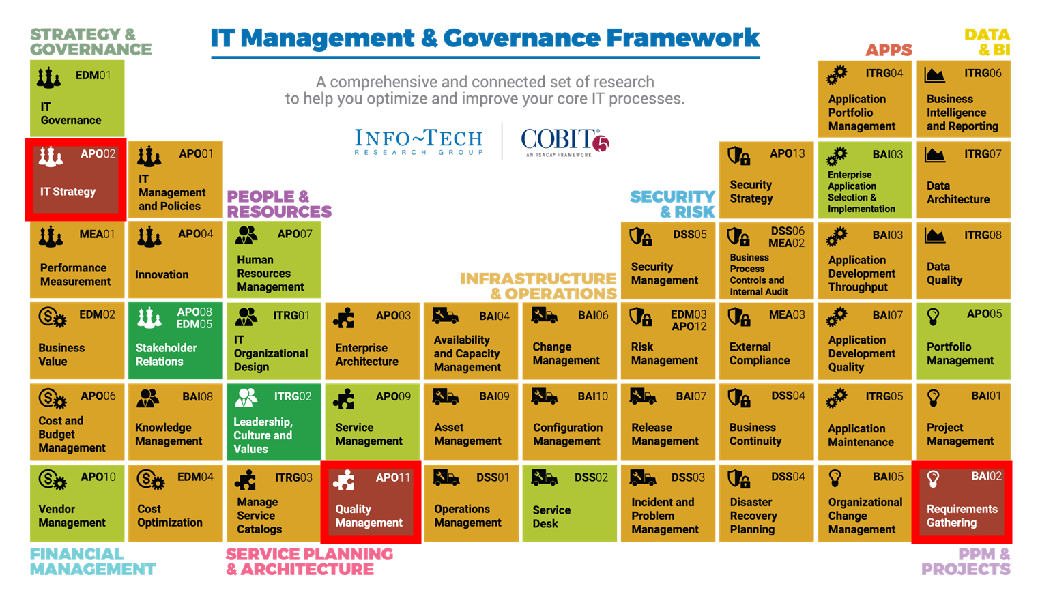
Prioritize processes as initiatives to enable IT excellence
3.2 Identify Key Initiatives
Once you’ve reviewed the MGD report, plot processes by their importance and effectiveness scores. Highlight any processes that are high importance and low effectiveness.
High
 | Maintain
Low Priority | Low Priority
High Priority
IT Strategy
Requirements Gathering
Stakeholder Relations
Quality Management
Portfolio Management
Importance
Cost Management
Security Management
Low
Satisfaction
High
Source: Info-Tech, Management & Governance Diagnostic

Slide 83
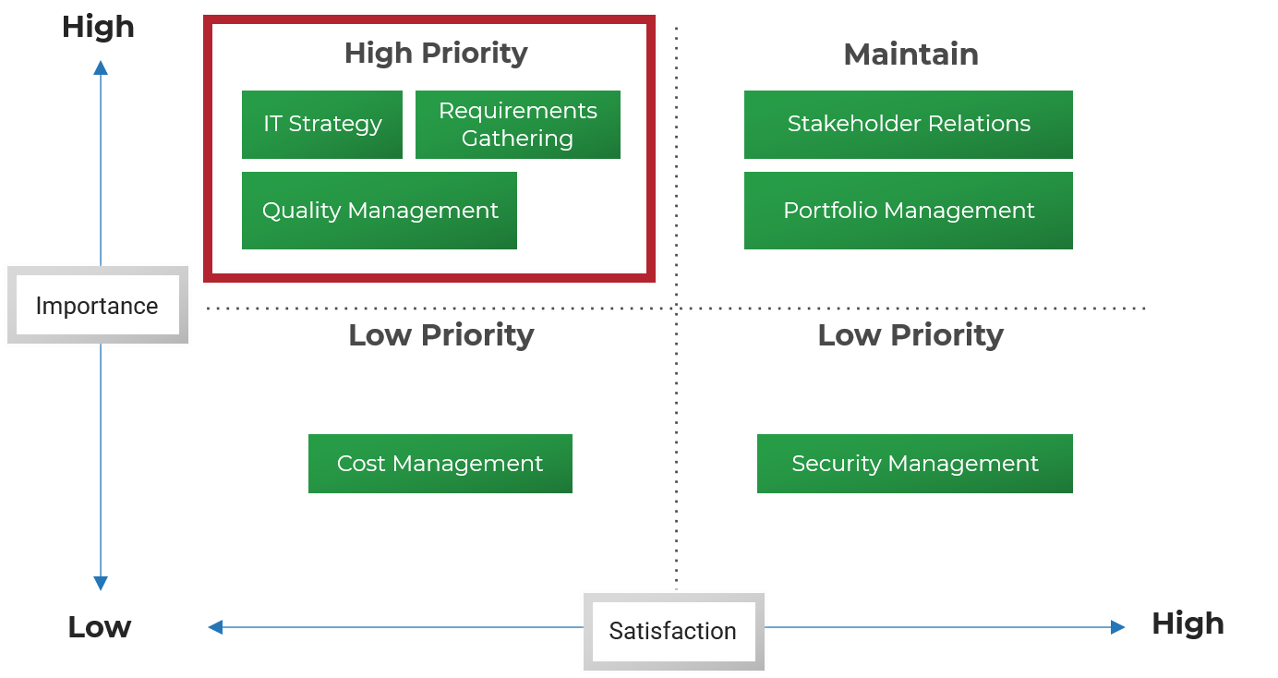
Brainstorm IT initiatives to improve core processes
3.2 Identify Key Initiatives
Brainstorm IT initiatives for each high-priority process using the framework below. Describe each initiative as a plan or action to take to solve the problem.
What processes must be created, changed or removed based on the data?
Process
Technology
=
Key Initiatives
What systems are required to improve this process?
Organization
What initiatives are required to manage people, data, and other organizational factors that are impacted by this process?

Slide 84
3.2.3 Identify and document your IT initiatives to enable IT excellence
3.2 Identify Key Initiatives
Input | Output
MGD data | IT initiatives
Materials | Participants
Collaboration/ brainstorming tool (whiteboard, flip chart, digital equivalent) Flip chart/sheets of paper Markers | CIO Senior IT Team
Objective: Use visuals to map out or articulate a particular issue, with emphasis on core steps within a process.
30 minutes
Review the MGD report and identify initiatives based on the following:
High Importance
Low effectiveness
2. Split into smaller groups and provide each group with their own low-maturity process from the diagnostic report.
3. Have participants identify all steps in the process and write them out on sticky notes.
4. Ask participants to flip over the paper and draw out the problem as they would explain it to a peer.
5. Have each participant or group present and explain the drawing to the team.
6. Have each team answer the following questions for problematic areas of the process:
What steps in the process must be created, changed, or removed based on your drawing?
What initiatives are required to manage people, data, and other organizational factors that are impacted by this process?
What systems are required to improve this process?
7. Identify process, technology, and organizational initiatives that are required to improve low-maturity processes.
8. Document your findings in the IT Strategy Workbook.
Download the IT Strategy Presentation Template to document your findings

Slide 85
Case Study
3.2 Identify Key Initiatives
INDUSTRY
COMPANY
Acme Corp. identified initiatives to enable IT excellence.
Professional Services
Acme Corp.
Low-Maturity Processes:
IT Excellence Initiatives:
2
IT Excellence
IT Strategy
Quality Management
Requirements Gathering
Improve communication of IT strategy
Improve automated testing
Standardize and improve Agile requirements gathering

Slide 86
3.2 Identify Key Initiatives
To drive technology innovation, focus on identifying industry and technology drivers that will have the most impact
Drive Technology Innovation
An industry-focused approach to driving technology innovation enables IT to look beyond what the business currently needs from us and take a proactive approach to how IT can propel the business forward and offer the company a competitive advantage.
3
Innovation
Understand the art of the possible with industry and technology trends research
Identify & prioritize use cases using industry reference architectures
Identify areas of high business investment
Formulate IT innovation initiatives

Slide 87
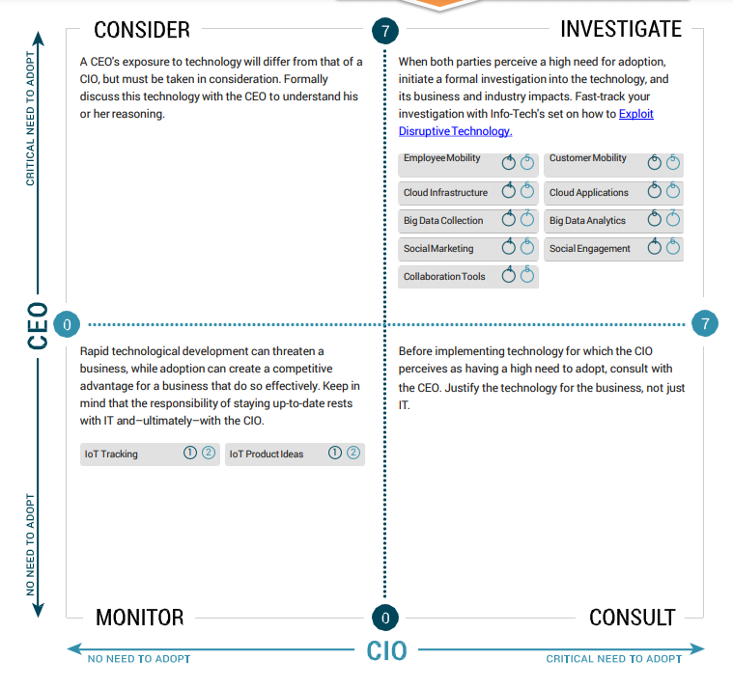
See where the CEO wants to invest in technology innovation
3.2 Identify Key Initiatives
These are ideal technology applications for which the CEO would like to drive adoption. Ensure you use this as a starting point to brainstorm use cases for innovation.
Begin with understanding the appetite for innovation technology, why the business wants to innovate, and should the business adopt these technologies in the next three to five years?
*Projects or initiatives that drive technology innovation must always be an explicit category in strategic planning.
Consider communicating these insights
Last Fiscal Year Strategy
Upcoming Year Strategy
Tech Adoption
Has IT moved the needle on any technology innovation areas that were surfaced last year? Which business goals did they support? Communicate these.
Do specific innovation drivers trigger projects or initiatives for the upcoming year? Incorporate these into the strategy.
Source: Info-Tech, CEO-CIO Alignment Diagnostic

Slide 88
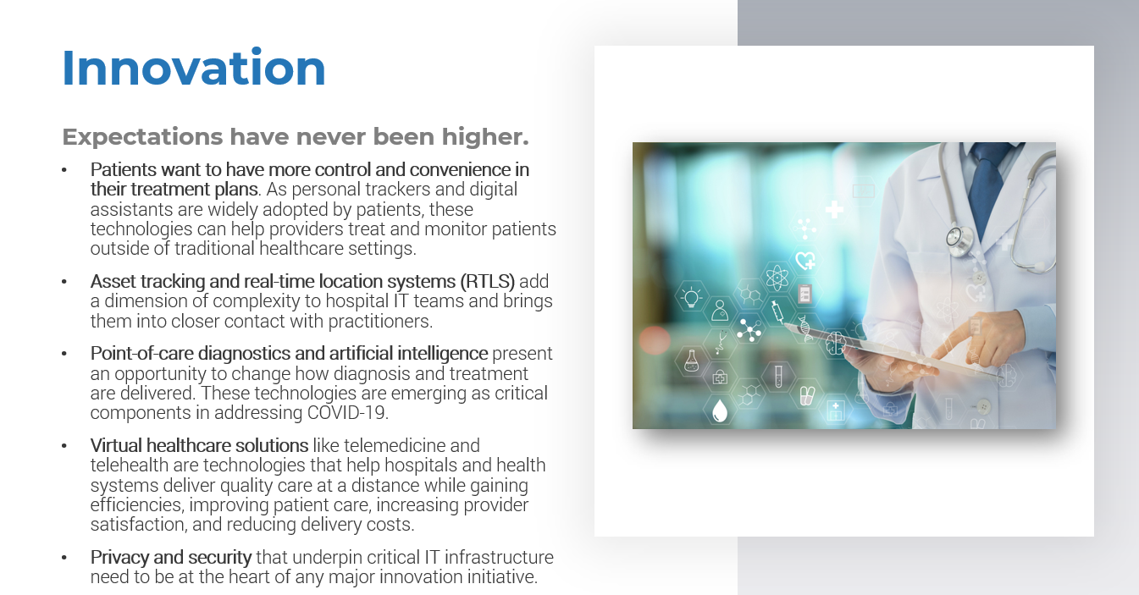
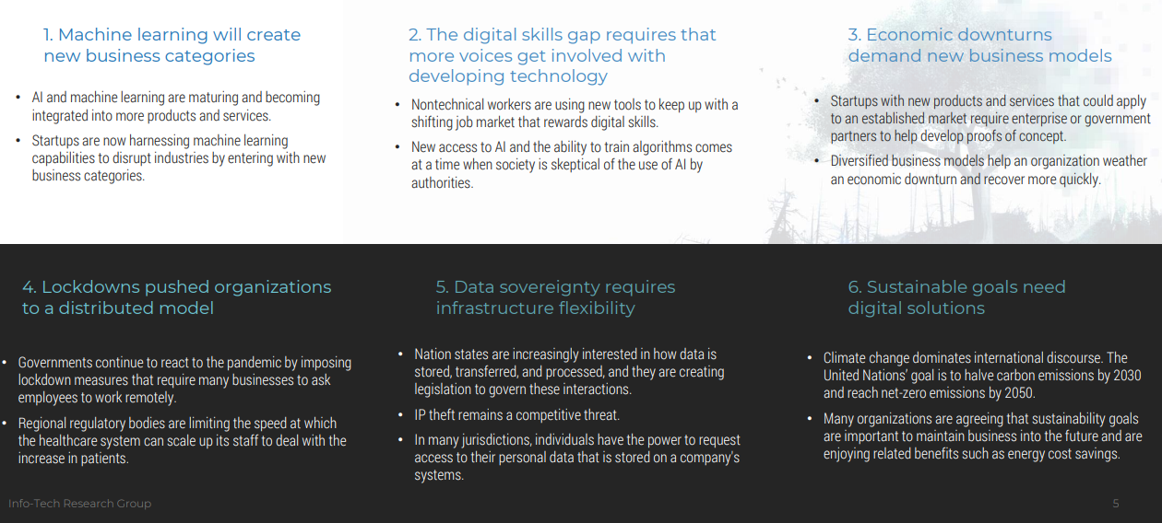
Leverage industry roundtables and trend reports to understand the art of the possible
3.2 Identify Key Initiatives
Uncover important business and industry trends that can inform IT’s possibilities for technology innovation. Explore trends in:
Budgeting
Staffing, Hiring & Retention
Senior Leadership & CIO Alignment
IT Capacity & Satisfaction
Critical Performance Areas
Creating new options from disruptive effects
And much more…
Market research is critical in identifying factors external to your organization and identifying technology innovation that will provide a competitive edge. It’s important to evaluate the impact each trend or opportunity will have in your organization and market. IT must be the driving force to recommending and enabling this change.
Visit Info-Tech’s Industry Coverage Research to get started.
Images are from Info-Tech’s Hospital Innovation Report and 2021 Tech Trends Report

Slide 89
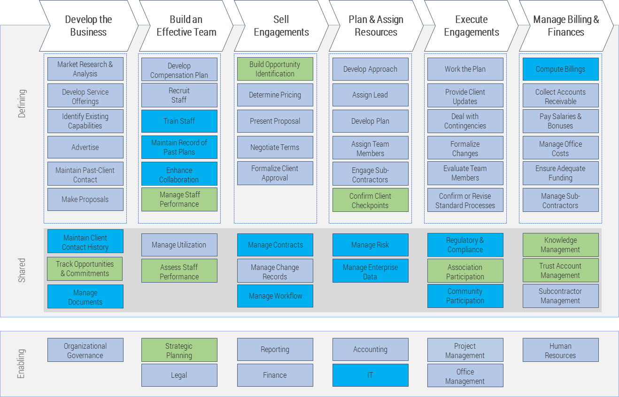
Identify innovation use cases by leveraging your industry capability map
3.2 Identify Key Initiatives
Your previously customized capability map also offers great insight into where innovation can be most impactful for your organization.
Begin by identifying and prioritizing the value streams that provide the most potential and value for innovation.
Single out capabilities that are strong and have high maturity at your organization. This activity helps determine where technology innovation thrives but also surfaces constraints within your organization where innovation might not be viable.
Elicit use cases based on high-priority capabilities.
A business capability defines what a business does to enable value creation, rather than how.
A use case is a behavior of the system that produces a measurable result of value to an actor.
Legend:
Capabilities that have high maturity within your organization.
Capabilities that provide high potential to create value to the value stream if automated.

Slide 90
Prioritize use cases based on value and potential
3.2 Identify Key Initiatives
Business demand for new technology is creating added pressure to innovate. If IT is not viewed as a source of innovation, its perceived value will decrease and the threat of shadow IT will grow.
Strong foundational knowledge on business and technology trends will result in identifying specific use cases that could offer your organization a competitive edge.
Remember to:
Identify and capitalize on opportunities for IT-led innovation.
Prioritize ideas and prototype solutions that will fuel organizational success.
Establish and formalize an effective IT-led innovation process.
Prioritize use cases that offer high value to the organization while still promising high potential within the constraints of your IT organization.
High
Medium Priority
High Priority
Build Real-Time Data & Dynamic Benchmarking Products
Use RPA for Finance & Billing Processes
Value
Low Priority
Low Priority
Hire or Partner With Independent Contractors
Low
Potential to Automate
High
Visit Info-Tech’s Kick-Start IT-Led Business Innovation blueprint to download the full methodology.

Slide 91
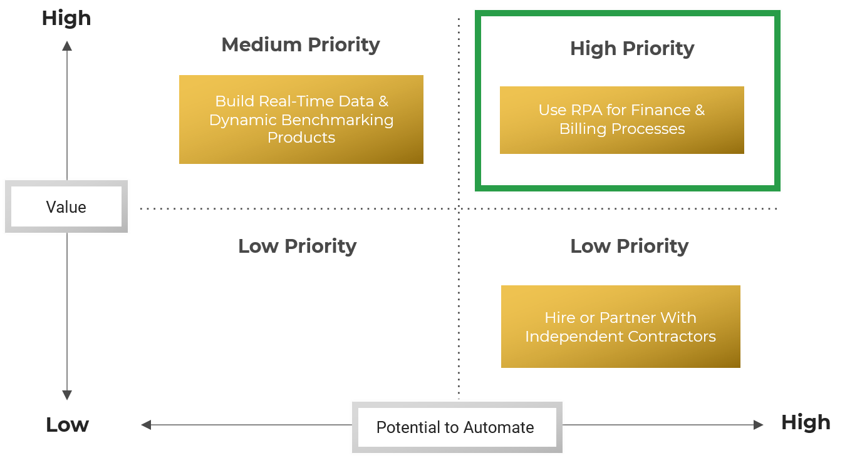
Define IT initiatives to drive technology innovation
3.2 Identify Key Initiatives
Brainstorm IT initiatives for each high-priority use case using the framework below. Describe each initiative as a plan or action to take to arrive at the use-case outcome.
What processes must be created, changed, or removed based on the data?
Process
Technology
=
Key Initiatives
What systems are required to improve this process?
Organization
What initiatives are required to manage people, data, and other organizational factors that are impacted by this process?

Slide 92
3.2.4 Identify and document your IT initiatives to enable technology innovation
3.2 Identify Key Initiatives
Objective: Identify, organize, and structure initiatives, and leverage the $100 test exercise to determine the value of and prioritize innovation initiatives.
60 minutes
Gather the IT strategy creation team.
Step 1: Identify innovation initiatives
Review diagnostic report data and other trends research and identify the following:
Your organization’s appetite for technology innovation
Areas of high investment for the business
High-impact use cases based on trends and industry research
Leverage your organization’s capability map to brainstorm specific use cases and plot them on the 2X2 matrix based on the value they could provide to the business and their potential to success based on your organization’s constraints.
Brainstorm respective initiatives to include in your key initiative plan.
Note: Use cases are behaviors of the system that produce a measurable result of value to an actor. Initiatives are projects with a definitive start and end date, and they enhance, create, maintain, or remove capabilities.
Step 2: The $100 Test
Prioritize use cases with high-potential value and automation.
Explain to each group that they have a maximum of $100 to spend on a pre-existing list of innovation initiatives. Dollar values should be assigned to items based on their importance and groups will need to prepare a rationale for their decision.
Remind the group to ignore the literal cost or effort associated with the item or initiative. The primary issue here is importance.
Each group will create a chart with two columns. On the left-hand side, record each initiative that has been evaluated; on the right, record the dollar amount allocated to each item.
When each group has completed the chart, compare and discuss the results and reasoning.
Document your findings in the IT Strategy Workbook.

Slide 93
3.2.4 Identify and document your IT initiatives to enable technology innovation (cont.)
Input | Output
Organization’s appetite for innovation and areas of investment Industry and market roundtables and technology trends Industry capability map | Innovation initiatives
Materials | Participants
Diagnostic and trend reports 2X2 matrix Collaboration/brainstorming tool (whiteboard, flip chart, digital equivalent) | CIO Senior IT Team
Download the IT Strategy Presentation Template and document your innovation initiatives.

Slide 94
Case Study
3.2 Identify Key Initiatives
INDUSTRY
COMPANY
Acme Corp. identified initiatives to drive technology innovation.
Professional Services
Acme Corp.
High-Priority Use Cases:
Innovation Initiatives:
3
Enable employee mobility through mobilizing business processes
Fully automate expense billing process
Acquire mobility suite to secure mobile apps
Acquire RPA platform
Train on RPA platform
Innovation

Slide 95
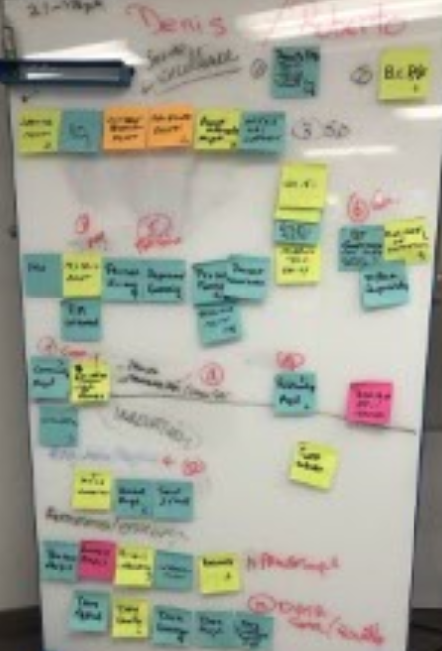
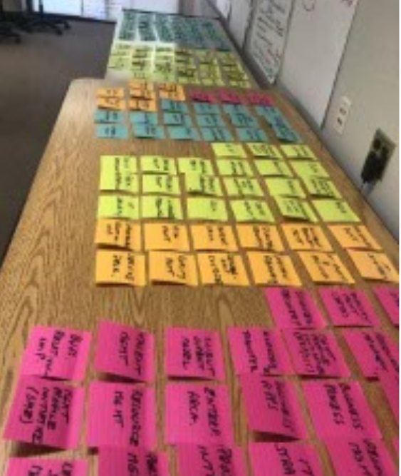
Consolidate projects into IT initiatives where needed
3.2 Identify Key Initiatives
Note: Use this step if the brainstorming activity resulted in too many granular projects on the list instead of high-level initiatives.
Use an affinity mapping approach to roll up individual projects or initiatives into major IT programs. A project represents a single body of work or solutions while a program will be a collection of similar projects that achieve the same end outcome. Programs are key to establish IT’s overall strategic goals and should be the focus or highlight of your strategic plan.
Affinity Mapping:
Gather all projects and solutions brainstormed from previous activities (regardless of their size).
Start to group them by similarity or the end outcome that they support.
If they are initiative level, ensure they are moved to the top of the affinity map to represent the overall theme.
If they are smaller projects, ensure they are categorized under the appropriate initiative name or brainstorm a name that fits the category if one does not exist.
At the end of this activity, you should be left with an affinity map that showcases your key IT initiatives that will be represented on your roadmap and the individual projects that support it (which will be used by your IT team to execute).

Slide 96
Frame IT goals that will resonate with your team
3.2 Identify Key Initiatives
An effective way to identify your IT goals is to reverse-engineer your key initiatives into high-level themes that will resonate and empower your IT organization.
Grouped by themes
Reframed as Goals
Key Initiatives
Themes:
IT Goals:
Customer Experience
Create a World-Class Customer Experience Capability
Stakeholder Satisfaction
Raise End-User Satisfaction by 85%
Initiatives are projects with a definitive start and end date, and they enhance, create, maintain, or remove capabilities.
A theme is a central topic, subject, or message within a narrative.
IT goals are high-level, specific objectives that the IT organization needs to achieve to reach the target state.

Slide 97
Identifying IT goals is the last step in your goals cascade
3.2 Identify Key Initiatives
IT goals are high-level, specific objectives that the IT organization needs to achieve to reach the target state.
IT goals begin a process of framing what IT as an organization needs to be able to do in the target state.
IT goals will help identify the target-state IT capabilities and the initiatives that will need to be implemented to enable those capabilities.
Business Goals
Business Initiatives
Business Capabilities
Support
Achieved Through
Create or Improve
IT
Capabilities
IT
Initiatives
IT
Goals
Create or Improve
Achieved Through

Slide 98
3.2.5 Identify your IT goals
3.2 Identify Key Initiatives
Objective: Leverage card sorting to gather, organize, and structure initiatives, and leverage storyboarding to provide visioning and big-picture views to elicit IT goals.
60 minutes
Gather the IT strategy creation team and revisit your IT initiatives.
Step 1: Card Sorting
On each card, include an initiative and a description that is succinct but contains enough information to describe what the initiative is.
Shuffle the deck and hand to the team. Describe the challenge and have the team sort the cards into groups that flow together.
The group should decide together on names and themes for each grouping.
Step 2: Storyboarding
After the card sorting exercise is conducted, similar initiatives should be grouped into themes. Give each theme a name and give each smaller group one theme to work on.
Identify your specific theme to be reviewed, e.g. “Your ideal vision of a help desk is...”
Provide individuals (or teams) with white paper and markers. Instruct them to draw their ideal state, using pictures, words, etc.
Participants can use multiple sheets of paper to draw processes, steps, or components of their ideal vision.
Have teams present their stories. Capture themes, insights, and “a-ha” moments.
Step 3: Finalize IT Goals
Read the IT goals slide (previous slide) to understand the characteristics of an IT goal. Review the examples on the previous slides with your team if you do not know where to begin.
Using the themes and storyboarding exercises outputs, create an IT goal that encompasses each of these implications. As well, create IT goals that achieve the vision and mission statements.
Continue the process until you are satisfied that the themes of IT implications and vision and mission statements are covered by the goals.
Document your findings in the IT Strategy Workbook.

Slide 99
3.2.5 Identify your IT goals (cont.)
Input | Output
IT initiatives IT goals definition | IT goals
Materials | Participants
IT Strategy Workbook Collaboration/brainstorming tool (whiteboard, flip chart, digital equivalent) 4x6 recipe/index cards (multiple colors) Flip chart paper Markers Large table space | CIO Senior IT Team
Download the IT Strategy Workbook and document your IT goals in the “Goals Cascade” tab to complete your goals cascade.

Slide 100
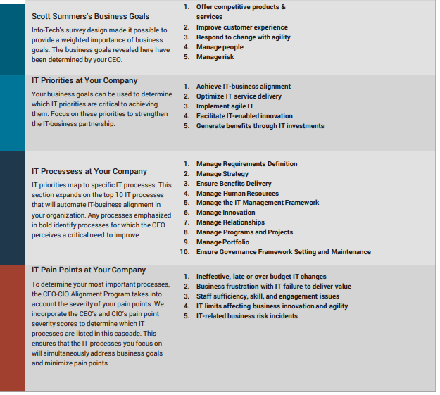
Align with the business through the goals cascade visual
3.2 Identify Key Initiatives
Use this personalized cascade as your guideline for strengthening IT's alignment with business goals. The cascade reveals business goals, streamlines the definition of IT priorities and processes necessary to achieve business goals, and identifies pain points that impede IT effectiveness.
Refine the results with your CEO and remember not to use the cascade mechanically. Keep in mind that goals and their respective importance will change over time. Revisit and refine the cascade annually.
A version of the goals cascade lives in your the IT Strategy Presentation Template. Ensure it has alignment to the diagnostic report.
Consider communicating these insights
Last Fiscal Year Strategy
Upcoming Year Strategy
When comparing to last year’s diagnostic report, how many critical pain points did IT address through strategic planning? How many goals/ priorities were addressed in last fiscal’s strategy? Communicate these.
Do specific priorities, processes and pain points trigger projects or initiatives for the upcoming year? Incorporate these into the strategy.
Goals Cascade

Slide 101
Case Study
3.2 Identify Key Initiatives
INDUSTRY
COMPANY
Acme Corp’s goals cascade:
Professional Services
Acme Corp.

Slide 102
Review your strategic choices for prioritization
The CIO must discuss IT goals and prioritization criteria with their executive peers and the head of the organization and set the expectations that these criteria shall be used to prioritize new IT initiative proposals.
As part of the Goals Cascade, you must identify the common themes that emerge from the IT initiatives. Later these themes can be articulated as IT goals.
Review these IT goals to ensure their align with the IT vision and support the strategic vision.
If there are any gaps, review the list of initiatives and make changes, if required, OR review the common themes to ensure they are correctly articulated as IT goals.
Your organizational strategic objectives, IT goals, and other organizational aspects will be used to draft your prioritization criteria.
Articulate your prioritization criteria in a way so you can evaluate the impact your IT initiatives will make on these criteria.
Also, review their weights to quantify the impact of these criteria on the organizational vision and strategic objectives. The sum of the criteria weight should be 100%.

Slide 103
Conduct a second round of prioritization (where needed) to determine your final list of strategic initiatives
3.2 Identify Key Initiatives
Leverage “Initiatives Information” in the IT Strategy Workbook to conduct a final prioritization.
Remember that alignment back to business goals was only conducted for the business support initiatives. Therefore, this prioritization effort ensures IT excellence and innovation initiatives put forward still support the organization’s business strategy and helps to streamline the number of initiatives that make it to your final strategy.
For all initiatives, determine the following and articulate your findings to business stakeholders in the formal strategy presentation:
Does the IT initiative support a particular business goal? If yes, document the level of alignment back to each business goal (high, medium, low, N/A).
Brainstorm and document the value of each initiative under the Value Statements column.
This exercise will help determine the order of priority for all initiatives based on their alignment back to business goals and help pick the top 12-15 initiatives that require attention in the next 12 months.
List all your initiatives and their key initiative plan category (business support, IT excellence, innovation).
Document your prioritization criteria and assign them weights based on their importance to business stakeholders.
Assign them a status (high, medium, low, N/A) based on their alignment back to the business goal.
A rank is automatically determined for each initiative based on the weighting exercise.

Slide 104
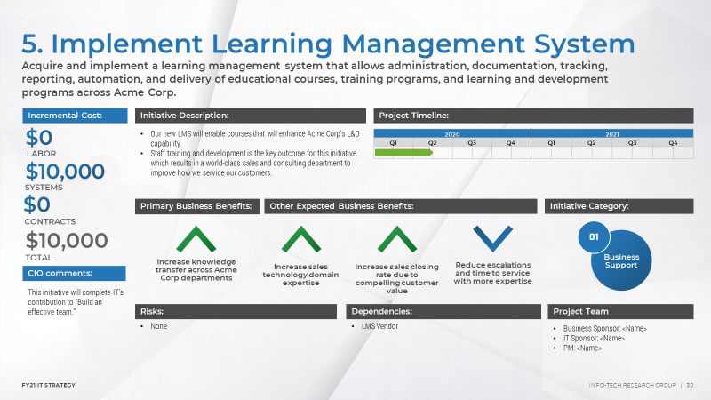
Create initiative profiles for each high-priority initiative on your strategy
3.3 Build Initiative Profiles
Example:
Outline the benefits achieved by completing this initiative. Think about the specific capabilities or strategic goals they will help support.
Add the initiative name and its value statement.
Although it will be difficult to get an accurate estimate for time and dollars required for initiatives while building the strategy, a ballpark within + / - 100% of the actual will help to begin to budget and scope the roadmap.
Add the key initiative category it belongs to.
Brainstorm who would be the main stakeholders involved in the initiative.
Brainstorm risks and dependencies for this initiative. These could be external or internal risks, dependencies on other initiatives or resources.

Slide 105
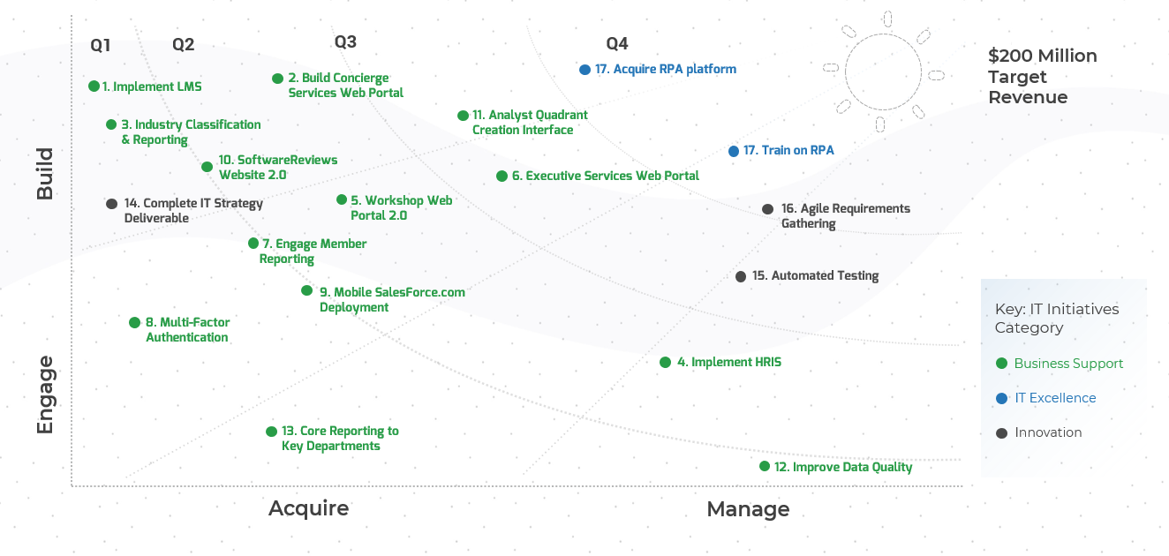
Build a roadmap to visualize your key initiative plan
3.4 Construct Strategy Roadmap
Visual representations of data are more compelling than text alone.
The roadmap is likely the best and most direct way to showcase your ideas to business leadership – take advantage of it.
Develop a high-level document that travels with the initiative from inception through executive inquiry to project management, and finally to execution. Understand an initiative’s key elements that both IT and the business need defined and that are relatively static over its lifecycle.
Initiatives are the waypoints along a roadmap leading to the eventual destination, each bringing you one step closer. Like steps, initiatives need to be discrete: able to be conceptualized and discussed as a single, largely independent item. Each initiative must have three characteristics:
Specific outcome: Describe an explicit change in the people, processes, or technology of the enterprise.
Target end date: When the described outcome will be in effect.
Owner: Who on the IT team is responsible for executing on the initiative.
Info-Tech Insight
Don’t project your vision three to five years into the future. Deep dive on next year’s big-ticket items instead.

Slide 106
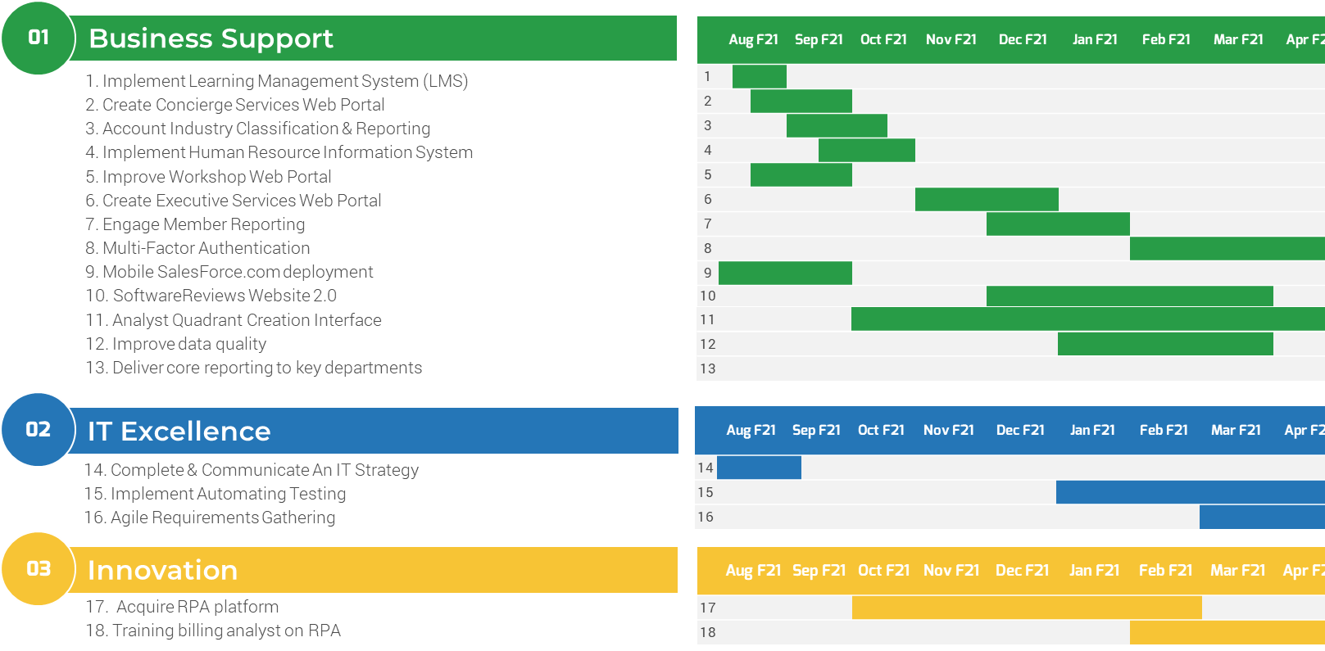
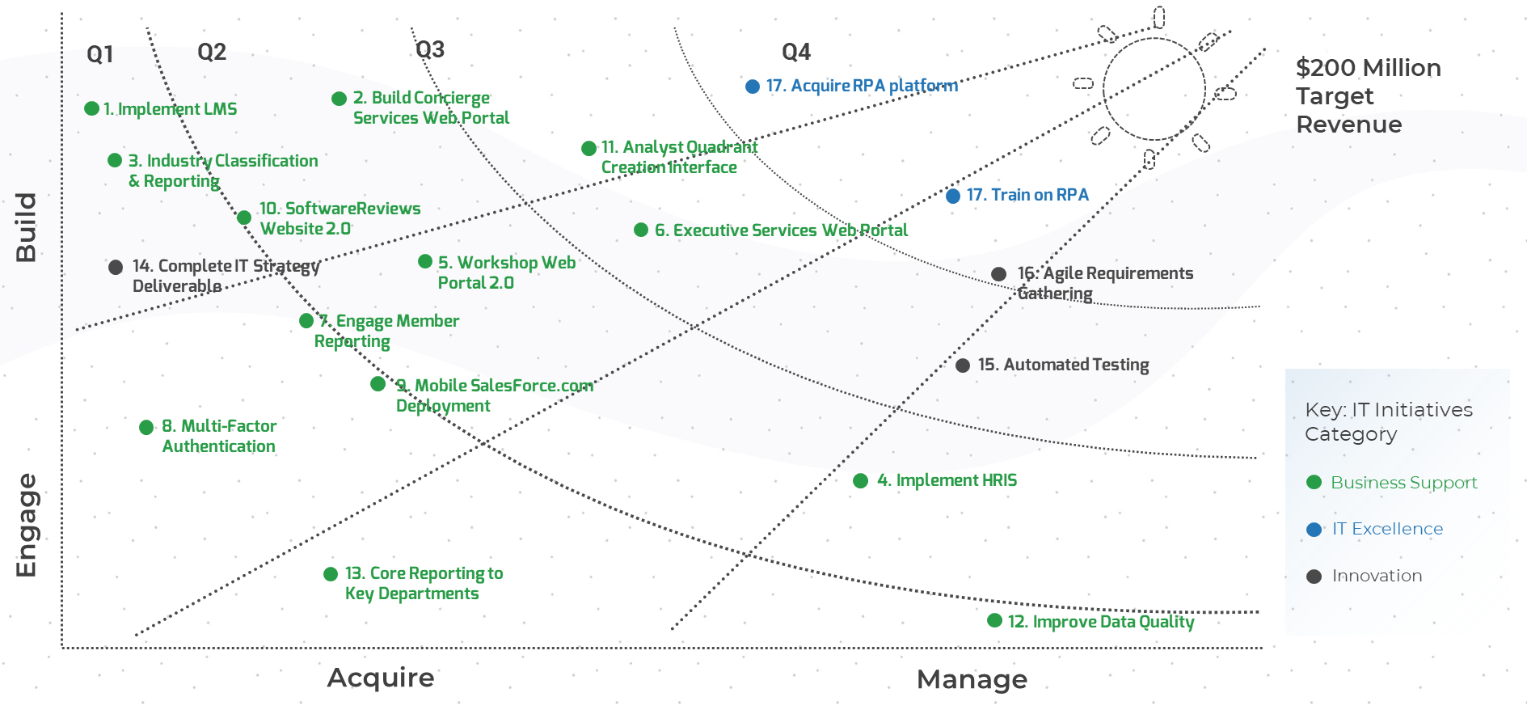
Illustrate the execution of IT initiatives using roadmaps
3.4 Construct Strategy Roadmap
Info-Tech recommends two different methods to roadmap the IT initiatives in your IT strategy.
Gantt Chart
Sunshine Diagram
This type of roadmap depicts IT initiatives, the associated goals, and exact start and end dates for each initiative. This diagram is useful for outlining a larger number of IT initiatives and for its easily digestible and repeatable format.
This type of roadmap depicts goals and their associated IT initiatives. The start and end dates for initiatives are approximated based on years. This diagram is useful for highlighting key IT initiatives and fitting them all on one page.

Slide 107
Bundle your initiatives for clarity and manageability
3.4 Construct Strategy Roadmap
Leverage the IT Strategy Workbook to auto-populate your roadmap into the Initiative categories.
In working through this methodology, you’ve already evaluated which category each initiative aligns to. Make sure to carry forward this categorization in your roadmap to allow for better communication of where IT plans to focus and how this impacts the business.
Business stakeholders will focus on initiatives aligned to support key strategic projects and IT’s innovation initiatives.
IT stakeholders will focus on initiatives that can lead to their team’s excellence and success.
You need to be able to explain the outcome of the project in terms that non-IT workers can appreciate. This is done by working as far up the goals cascade as you have defined, which gets to the underlying business outcome that the initiative supports.
Note: Ruthlessly evaluate if an initiative should stand alone or can be rolled up with another. Fewer initiatives increases focus and alignment, allowing for better communication.

Slide 108
3.4.1 Build your roadmap
3.4 Construct Strategy Roadmap
Input | Output
IT initiatives Initiative start and end dates Initiative category | IT strategy roadmap visual
Materials | Participants
IT Strategy Workbook | CIO Senior IT Team
30 minutes
Gather the IT strategy creation team and open the IT Strategy Workbook to tab 5.
Discuss with the IT strategy creation team if the IT strategy should contain the Gantt chart or the sunshine diagram or both.
For the Gantt chart:
Input the Roadmap Start Year date.
Change the months and year in the Gantt chart to reflect the same roadmap start year.
Populate the planned start and end dates for the pre-populated list of high-priority initiatives.
Document your final roadmap visual in your IT Strategy Presentation Template.
Download the IT Strategy Workbook to document your findings

Slide 109
3.4.2 Build your sunshine diagram
3.4 Construct Strategy Roadmap
Input | Output
IT initiatives Initiative start and end dates Initiative category | Sunshine diagram visual
Materials | Participants
Flip chart paper/whiteboard Markers | CIO Senior IT Team
Objective: Build a summary visual used to capture strategic initiatives over time, using themes and timelines.
30 minutes
Gather the IT strategy creation team and review your list of key initiatives.
Work with the team to identify key themes and directions.
Build model with “rays” radiating out from a central theme or objective.
Using curved arcs, break the grid into timeline periods.
Work with the team to map goals identified in brainstorming activity to plot against timelines and key themes.
Document your findings in the IT Strategy Presentation Template.
Download the IT Strategy Presentation Template to customize your sunshine diagram.

Slide 110
Case Study
3.4 Identify Key Initiatives
INDUSTRY
COMPANY
Acme Corp’s Roadmap and Sunshine Diagram:
Professional Services
Acme Corp.

Slide 111
Finalize your key initiative plan
3.4 Construct Strategy Roadmap
Your key initiative plan section of the IT Strategy Presentation Template helps develop and communicate an impactful plan of action for IT’s strategic goals.
Why is this important? It helps you:
Show alignment to the business using an end-to-end goals cascade approach.
Improve IT’s own maturity by accommodating strategic projects that will result in higher process and operational success.
Institutionalize the ongoing exploration and evaluation of new technologies by IT to place them in the proper enterprise context.
Socialize the roadmap early and often; take an iterative and interactive rather than a monolithic and dictatorial approach.
Business Trends & Technology Innovation Initiatives
Process Maturity & IT Excellence Initiatives
Business Context & Business Support Initiatives
Visualization & Communication
IT Strategy Key Initiative Plan & Roadmap Visual
Input information into the IT Strategy Presentation Template

Slide 112
Build your key initiative plan
Elicited business context from the CIO and IT team.
Identified key initiatives that support the business.
Identified key initiatives that enable IT excellence.
Identified initiatives that drive technology innovation.
Built initiative profiles.
Constructed your strategy roadmap visual.

Slide 113
Phase 4
This phase will walk you through the following activities:
Establish Governance
Evaluate Budget
Evaluate Organizational Changes
Build Functional Support Roadmaps
Finalize Your IT Strategy
This phase involves the following participants:
CIO
Senior IT Team
Define Your Operational Strategy
Phase 1
Phase 2
Phase 4
4.1 Establish Governance
4.2 Evaluate Organizational Changes
4.3 Evaluate Budget
4.4 Build Functional Support Roadmaps
4.5 Finalize IT Strategy
Build a Business-Aligned IT Strategy
Phase 3

Slide 114
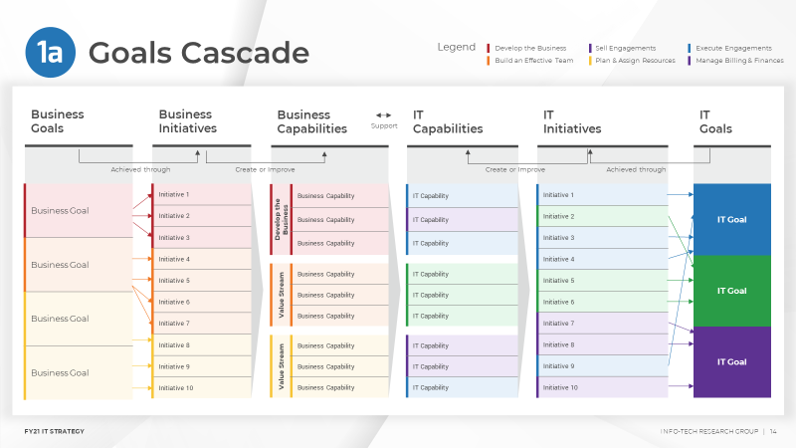
To complete this phase, you will need:
Your Key Initiative Plan
IT Strategy Presentation Template
Use the key initiative plan built in phase 3 as an input for the following activities:
Establish Governance
Evaluate Budget
Evaluate Organizational Changes
Build Functional Support Roadmaps
Use the IT Strategy Presentation Template to document the results from all activities conducted in this phase and to present to business and IT stakeholders.

Slide 115

Your operational strategy is IT facing
4.0 Operational Strategy
While business stakeholders care about what IT is working on and when they can expect it, your IT team will be asking the question of how to get the work done and reach the target state.
Ensure IT can deliver what they promise by building a strong operational strategy.
“Operational strategies [refer] to the methods companies use to reach their objectives. By developing operational strategies, a company can examine and implement effective and efficient systems for using resources, personnel and the work process.”
Source: Chron.com, 2019
Key Initiative Plan
Operational Strategy
what & when
how
Planning
Execution
Business
IT

Slide 116
Your operational strategy is key to execution
4.0 Operational Strategy
GOVERNANCE
Strong governance (stakeholder and risk management, KPIs) is key to executing on what is important and to keeping your team on track.
1
ORGANIZATIONAL CHANGES
Evaluate resourcing and the current operating model to ensure the work gets done.
2
BUDGET
Evaluate budgetary changes and requirements to support your strategy.
3
FUNCTIONAL ROADMAPS
Evaluate the team-level projects required to complete key initiatives.
4

Slide 117
Establish governance practices to ensure the success of your team
4.1 Establish Governance
IT governance sets direction through prioritization and decision making and monitors overall IT performance. Governance aligns with the mission and vision of the organization to guide IT.
In this section, we will cover stakeholder management, risk management, and establishing metrics and targets as a minimum effort to establish strategic governance.
Evaluate
Governance ensures that business goals are achieved by evaluating stakeholder needs, criteria, metrics, portfolio, risk, and definition of value.
Info-Tech Insight
Developing an IT strategy is a wasted effort if no mechanisms are put in place to govern the journey.
Governance is performed in three ways:
Direct
Governance sets the direction of IT by delegating priorities and determining the decisions that will guide the IT organization.
Monitor
Governance establishes a framework to monitor performance, compliance to regulation, and progress on expected outcomes.
Visit Info-Tech’s Improve IT Governance blueprint to download the full methodology.

Slide 118
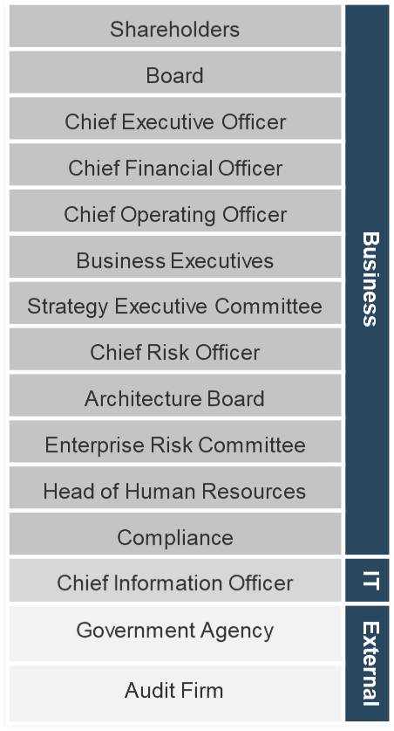
IT must commit to frequent and effective stakeholder communication
4.1 Establish Governance
For each business support initiative, evaluate and identify the following:
Initiative
Key IT Teams
Business Units Impacted
Key Contacts in Business Unit
Communication Methods
Which are the key IT teams involved?
Initiative Name
Which stakeholder groups are impacted by this initiative?
Who is the primary contact within each impacted stakeholder group?
What communication methods are most effective for each business contact?
Web Team
SVP
Weekly Status Update meeting
VP
Weekly Demo
Examples
Sales Ops
Product Owner
Daily Standup
Infrastructure
Product Specialist
General Communications
Liaison
Service Desk
Creative Team

Slide 119
4.1.1 Establish stakeholder communication
4.1 Establish Governance
Input | Output
IT initiatives IT teams and stakeholders | Impacted stakeholders and business contacts Communication methods
Materials | Participants
IT Strategy Workbook Collaboration/ brainstorming tool (whiteboard, flip chart, digital equivalent) | CIO Senior IT Team
Objective: Build an effective stakeholder communication program.
30 minutes
Gather the IT strategy creation team and revisit your IT initiatives.
Brainstorm in smaller groups.
Assign one initiative to each group and answer the following questions for each:
Which are the key IT teams involved?
Which stakeholder groups are impacted by this initiative?
Who is the primary contact within each impacted stakeholder group?
What communication methods are most effective for each business contact?
Share in the larger group and assign a notetaker to document in the Workbook.
Download the IT Strategy Presentation Template to document your findings.

Slide 120
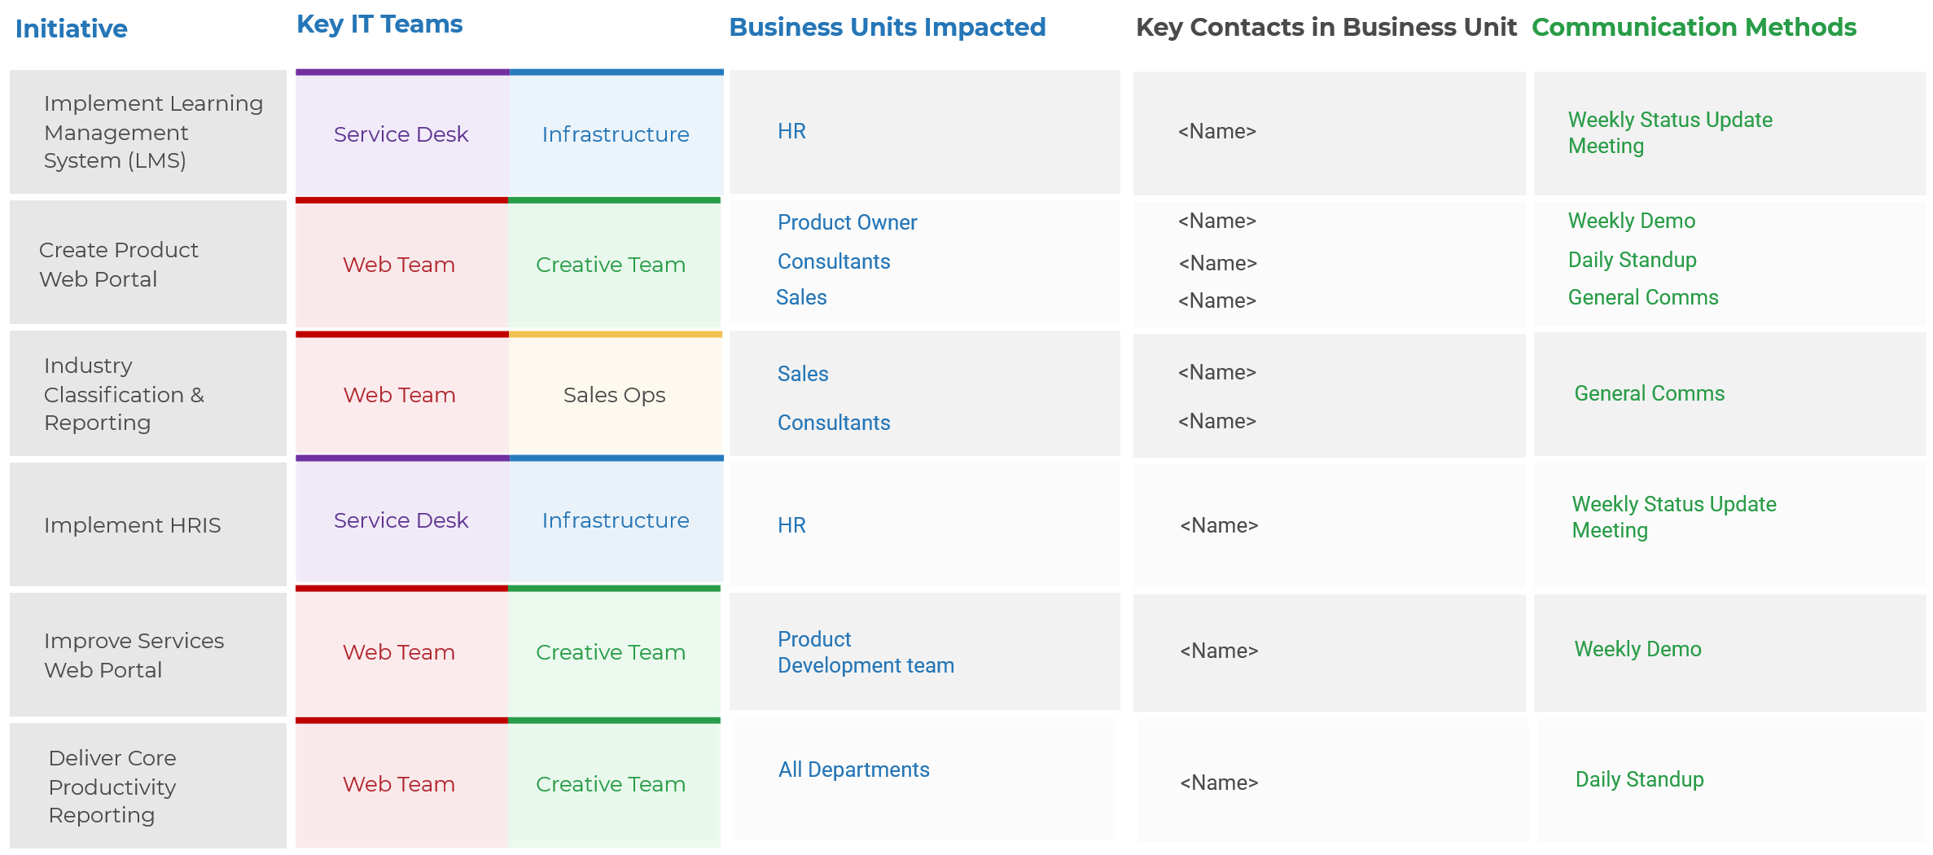
Case Study
4.1 Establish Governance
INDUSTRY
COMPANY
Acme Corp’s Stakeholder Management Approach:
Professional Services
Acme Corp.

Slide 121
Create a strategy for managing and mitigating risks for your key initiatives
4.1 Establish Governance
Take a proactive stance against IT threats and vulnerabilities by identifying and assessing IT’s greatest risks before they occur and have serious implications. This is important information needed for the business to trust that IT is going to deliver on strategic priorities and to be aware of the risks IT will be mitigating vs. accepting. After all, IT risk is business risk. Every IT risk has business implications. Create an IT risk management program that shares accountability with the business.
Identify Strategic Risk
You’ve begun identifying risks associated with your strategy on your initiative profiles.
Risk Identification
Risk Assessment
Assess Strategic Risk
Consolidate all initiative risks from your initiative profiles and identify the groups of strategic risk that are posed to your portfolio.
Respond to High Priority Risks
Create a plan to mitigate high-priority risks and include this in your final strategy presentation.
Govern & Manage Risks
Risk Governance
Risk Response
Ensure there is continued governance to manage the risks identified and include key stakeholders in all communication.

Slide 122
Track progress towards IT goals with effective metrics and targets in place
4.1 Establish Governance
Refer back to the IT goals defined in the first section of your operational strategy. IT goals can also be referred to IT’s critical success factors that must be met to reach your strategic vision. Consider them the starting point to determine which metrics you want to track.
Refer to IT Goals Defined
Determine which metrics will be appropriate for your organization and prepare for reporting. Look for potential problems or areas for improvement and plan for capacity growth/contraction depending on expected changes to system demand, strategic projects, and so on.
Identify Metrics to Align to Each IT Goal
Progress towards IT goals must be tracked through realistic and actionable targets that your team can deliver on. Spend your time where you can have the greatest impact.
Identify Target and Reports
Create Effective Communication in Your Strategy
Document your metrics and targets in your IT Strategy Presentation Template along with the alignment back to IT goals.

Slide 123
4.1.2 Identify metrics and targets
4.1 Establish Governance
Input | Output
IT goals IT teams and stakeholders | Metrics Targets
Materials | Participants
IT Strategy Workbook Collaboration/ brainstorming tool (whiteboard, flip chart, digital equivalent) | CIO Senior IT Team
Objective: Identify metrics and targets that will help track your team’s progress towards your strategic goals.
30 minutes
Gather the IT strategy creation team and revisit your IT goals. Break out into smaller random groups (as many groups as the number of IT goals you have).
Assign one goal to each group and brainstorm the following:
Key metrics (2-3 per goal)
Targets (1 per key metric)
Identify key metrics for each goal. Consider metrics that:
Are related to critical business services, functions, or corporate goals
Address known/visible pain points for the business
Were designed for supportive or influential stakeholders
Identify corresponding targets for each metric. Identify an initial service objective based on one or more of the following options:
Realistic and achievable by your team
Easy to measure and track
Establish an initial target using historical data and trends of performance
Establish an initial target based on stakeholder-identified requirements and expectations
Prioritize one metric that is of highest value for each goal. Share in the larger group and assign a note taker to document in the IT Strategy Presentation Template.
Download the IT Strategy Presentation Template to document your findings

Slide 124
Evaluate any resourcing changes required to support your strategy
4.2 Evaluate Organizational Changes
Part of your operational strategy is identifying how your key initiatives will impact the way your team currently operates. The CIO and the IT organization establish the appropriate IT operating model after strategic planning is complete. The organizational structure determines how teams will be structured and staffed to deliver services to consumers in the most appropriate way.
What is organizational structure?
The arrangement of lines of authority, rights, communications, and duties of an organization. The structure determines how the roles, power, and responsibilities are assigned, controlled, and coordinated across the IT organization.

Slide 125
Evaluate the organizational structure to encourage collaboration and to develop the culture to deliver the relevant services
4.2 Evaluate Organizational Changes
Organizational design:
The standardized and wide scope of work lends itself well to having functional groups and domain-driven silos in which the teams can focus on delivering or supporting one or more foundational and common services.
For foundational services, success should be measured by IT metrics specific to the services being delivered.
Roles, responsibilities, and competencies:
The people in these groups benefit from having analytical, linear, and specialized skills in the domain of the foundational or common service.
The main responsibilities for the individual/team managing the foundational services should be to ensure the consistent and high-quality delivery of the services.
Success measurement:
For common services, success should be measured through a combination of business and IT metrics that indicate the service contribution to business value.
Organizational Structure
How teams are organized
Competencies and behaviors
Success measurement
At the minimum, you must evaluate how strategic changes will require augmenting your current organizational structure. For smaller organizations, analyzing FTEs required and changes in reporting structure will suffice. However, the more transformative your strategy is, the more it will require looking into augmenting your operating model or redesigning your IT organizational structure to deliver effectively.
Visit Info-Tech’s Redesign Your Organizational Structure blueprint and Optimize the IT Operating Model blueprint for additional information.

Slide 126
Identify resourcing information that supports the IT strategy
4.2 Evaluate Organizational Changes
It’s important to communicate to your team who will be supporting strategic initiatives and how. Ensure there is alignment back to your key initiatives when you propose any changes to the existing resource structure.
Structure follows strategy – how your organization is designed will dictate how it behaves. It is the key enabler of your strategic direction.
Map corporate drivers to department-level resources to show how changes in IT’s resourcing structure can benefit the organization.
Additional Resource Requirements
Functional Area of IT
Alignment to Corporate Goals
Key Initiatives
Implement Automated Testing
QA Analyst
Web Team
Operations
Build Product Web Portal
UX Designer
Creative Team
Revenue Driven
Acquire RPA Platform
N/A
N/A
Cost Efficient
Implement HRIS System
Developer
Web Team
Cost Efficient
Improve Data Quality
N/A
N/A
Operations

Slide 127
Identify changes required to reporting structure based on resourcing changes
4.2 Evaluate Organizational Changes
<Name>
CIO
<Name>
<Name>
<Name>
<Name>
<Name>
VP
VP
VP
VP
VP
+1 FTE
+8 FTE
<Name>
+1 FTE
+1 FTE
<Name>
<Name>
<Name>
<Role>
<Role>
<Role>
<Role>
5 FTEs
9 FTEs
What impact is there to reporting relationships within the department? And what are the roles of key people during the transition?
<Name>
<Name>
<Name>
<Name>
<Name>
<Name>
<Role>
<Role>
<Role>
<Role>
<Role>
<Role>
5 FTEs
5 FTEs
5 FTEs
8 FTEs
<Name>
-8 FTE
<Role>

Slide 128
4.2 Identify organizational changes required
4.2 Evaluate Organizational Changes
Input | Output
IT initiatives IT team and current resourcing | Changes to resourcing (in FTEs) Changes to reporting structure
Materials | Participants
IT Strategy Workbook Collaboration/ brainstorming tool (whiteboard, flip chart, digital equivalent) | CIO Senior IT Team
30 minutes
Gather the IT strategy creation team and revisit your IT goals.
Brainstorm the implications of your IT strategy initiatives on your organizational structure. Specifically:
Resource addition requirements for each initiative (if any)
Functional areas of IT that the resource is required in
Alignment back to corporate goals for each key initiative that shows the % of IT support for each corporate goal
Brainstorm any changes to reporting structure brought on by additional resource requirements.
Where in the IT organization will existing resources need to transition to?
What are their roles during the transition?
Document your findings in the IT Strategy Presentation Template.
Download the IT Strategy Presentation Template to document your findings.

Slide 129
Calculate the incremental cost of each key initiative
4.3 Evaluate Budget
Each key initiative has already been categorized under one of the following buckets. Carry this categorization forward for your budget as well.
Incremental cost of key initiatives is calculated by identifying the following costs for each initiative:
1
Labor
01
Costs associated with the members of a particular organization who perform work. Brainstorm cost for number of resources and skill set required.
1
Business Support
2
Systems
Key Initiative Plan
02
2
IT Excellence
Costs associated with purchasing, developing, integrating, or maintaining any new systems or applications.
3
Contracts
3
Innovation
03
Costs associated with contract workers and consultants and money paid to vendors for software, hardware, and other services.

Slide 130
Present additional budget information to business stakeholders
4.3 Evaluate Budget
Each key initiative has already been categorized under one of the following buckets. Carry this categorization forward for your budget as well.
Estimate of expenses to be incurred in the next 12-month period. The outflow of funds reflects an operational plan for achieving organizational objectives. There are two major types of expenses: capital costs and operating costs.
1
Capital Costs
01
Capital Cost: Expenses incurred to buy things. This type of spending is related to the acquisition of assets. In an IT environment, capital costs include:
Purchasing a server.
An integration consulting fee incurred to set up a new system.
1
Business Support
Key Initiative Plan
2
IT Excellence
2
Operating Costs
02
Operating Cost: Expenses incurred to run the organization. This type of spending is related to the provision of services. In an IT environment, operating costs include:
Labor
Maintenance fees
3
Innovation

Slide 131
Identify the new ask for IT’s budget by comparing it to historical data
4.3 Evaluate Budget
Your audience won’t understand the value of IT if you can’t communicate the benefit(s).
An IT budgeting process must contain adequate measures to capture and communicate the benefit of IT investments.
This begins with the collection of data and ends with effectively presenting the benefits IT investments will have for the business.
Example data to compare IT budgets.
2020 budget + cost of 2021 strategy = 2021 budget
Budget | 2021 | 2020
Capital
Business Support | $532,500 | $425,000
IT Excellence | $312,500 | $310,000
Innovation | $135,000 | $120,000
Subtotal | $1,000,000 | $855,000
Operating
Business Support | $1,077,500 | $950,000
IT Excellence | $750,500 | $750,000
Innovation | $265,000 | $250,000
Subtotal | $2,093,000 | $1,950,000
Total | $2,965,000 | $2,695,000
Identify as much of the same budget data from your previous 12-month period/fiscal.
This helps identify the delta in budgetary requirements for the upcoming strategy.
Visit Info-Tech’s Build an IT Budget blueprint or Establish a Service-Based Costing Model blueprint to download the full methodology and learn more about how to effectively budget.
+$270K

Slide 132
4.3 Identify IT’s target budget for your strategy
4.3 Evaluate Budget
Input | Output
IT key initiatives Historical budget information (last fiscal) | Incremental costs for each key initiative Changes in capital and operating costs
Materials | Participants
IT Strategy Workbook Collaboration/ brainstorming tool (whiteboard, flip chart, digital equivalent) | CIO Senior IT Team
30 minutes
Gather the IT strategy creation team and revisit your list of key initiatives.
Identify the incremental cost of each initiative by brainstorming and discussing the following:
Labor costs: What are the ongoing and new costs associated with the IT staff who perform work?
Systems costs: What are the costs associated with purchasing, developing, integrating, or maintaining any new systems or applications?
Contracts costs: What are the costs associated with contract workers and consultants as well as vendors for software, hardware, and other services?
Identify the breakdown of capital and operating costs for each major key initiative plan category (business support, IT excellence, innovation):
Capital costs: What are the new costs incurred to buy things and acquire new IT assets?
Operating costs: What are the costs incurred to run the IT organization and are related to the provision of services?
Document your findings in the IT Strategy Presentation Template.
Download the IT Strategy Presentation Template to document your findings

Slide 133
Functional roadmaps include the team-level projects required to complete initiatives
4.4 Build Functional Roadmaps
The final step in building your operational strategy is to identify the team-level projects that will need to be executed to support each key initiative. These functional roadmaps will augment your strategy with tactical projects and outline the time, duration, effort, and resources required. The strategy team is accountable for building these roadmaps, while functional leaders are responsible for executing them along with their teams.
IT STRATEGY
Strategic & Directional
Build Product Web Portal
Key Initiative
Key Initiative
Functional Area of IT
Application Development
Creative/Design
Infrastructure & Operations
Project 1
Build redundancy
Project 2
Agile team full-time
Website redesign
Operational & Time-Boxed
Project 3
Explore new compute methods
Project 4
Data management

Slide 134
Begin with identifying all functional areas within your IT team
4.4 Build Functional Roadmaps
Applications
Infrastructure & Operations
Security & Risk
Data & Business Intelligence
Identifying the different functional areas within your IT organization and their respective leaders will help determine how each key initiative will impact your teams and the work involved for each team. This level of rigor and discipline to project planning can be beneficial to your team’s success in supporting strategic initiatives.
Planning and controls should help drive progress and mitigate risk.
Reporting should help communicate KPIs and inform decision makers.
Project governance should help ensure that process accountabilities are clearly defined and followed.
Innovation
Vendor Management
Creative/Design
Enterprise Service Planning
Project & Portfolio Management
Etc.

Slide 135
4.4 Build functional roadmaps
4.4 Build Functional Roadmaps
Input | Output
IT key initiatives Functional teams and impact | Team-level projects list Functional roadmaps visuals
Materials | Participants
IT Strategy Workbook Collaboration/ brainstorming tool (whiteboard, flip chart, digital equivalent) | CIO Senior IT Team
30 minutes
Gather the IT strategy creation team and revisit your list of key initiatives.
Identify and list all your functional teams within IT.
Consider one key initiative at a time, and brainstorm the following for each functional group:
What is the impact and expected outcome of this initiative from the team?
What project(s) must be completed by this team to achieve the outcome?
What are the project start and end dates?
Download the IT Strategy Presentation Template to document your findings

Slide 136
Finalize and communicate your IT strategy to the business
4.5 Finalize IT Strategy
Use these sections of the final IT Strategy Presentation Template as a guide to communicate your strategy to different stakeholder groups.
1
2
3
4
FY IT Strategy
FY IT Goals & Operating Strategy
FY Technology Roadmaps
Year-in-Review
Audience: Business
This section includes IT’s mission, vision, key initiatives, roadmap budget, and risk information.
What will IT work on and why?
Audience: IT
This section includes IT goals and all components of your operational strategy that your team needs to know.
How will IT ensure success?
Audience: IT
This section includes detailed functional roadmaps for each key initiative.
What projects are required to execute on initiatives?
Audience: Business and IT
This section includes the key highlights from IT’s strategy and achievements over the last fiscal year.
How did IT perform last year?
Info-Tech Insight
If you don’t communicate it, it doesn’t exist; simple, appealing, and inspirational communication is needed.

Slide 137
4.5.1 Create a next steps checklist
4.5 Finalize IT Strategy
Input | Output
IT strategy Functional teams and impact | Next steps checklist
Materials | Participants
IT Strategy Presentation Template Collaboration/ brainstorming tool (whiteboard, flip chart, digital equivalent) | CIO Senior IT Team
30 minutes
Gather the IT strategy creation team and revisit your final IT strategy.
Present the IT strategy for approval from stakeholders, using information created in this blueprint.
Refine the initiative roadmap based on decisions for risk and budget.
Secure approval for the initiative roadmap and IT strategy.
After approval, create a communication plan.
With the IT strategy approval, the big picture of the IT strategy has been communicated to the higher-level personnel in the organization.
Build a plan to communicate the big picture to all IT and business personnel involved in initiative execution.
Further, build out the communication plan to include provisions for ensuring that execution of the IT strategy is top of mind for all personnel involved.
Make sure the IT communication plan is targeted to the individuals working on each initiative. It is important for each team member to understand how the initiatives they are staffed on will impact IT’s vision and mission and the overall organization.
Download the IT Strategy Presentation Template to document your findings

Slide 138
Include functional strategies in your next steps checklist
4.5 Finalize IT Strategy
Applications Strategy
Review Your Application Strategy
Data Quality
App Dev Throughput
ERP Selection
Infrastructure & Operations Strategy
Build the Business by Building an Infrastructure Roadmap
Change Mgmt.
Asset Mgmt.
Cloud Strategy
IT Strategy
Security Strategy
Build an Information Security Strategy
DRP
External Compliance
Risk Mgmt.
As part of your next steps checklist, identify the specific functional strategies that would be required to help your team during the execution phase. This can include processes and other impacts that need to be addressed on your strategy.
Vendor Management Strategy
Jump Start Your Vendor Management Initiative
Strategy & Sourcing
Negotiations & Contracts
Governance & Evaluation

Slide 139
Create a refresh strategy
4.5 Finalize IT Strategy
It is important to dedicate time to your strategy throughout the year. Create a refresh plan to assess for the changing business context and its impact on the IT strategy. Make sure the regular planning cycle is not the primary trigger for strategy review. Put a process in place to review the IT strategy and make the IT organization proactive. Start by examining the changes to the business context and how the effect would trickle downwards. It’s typical for organizations to build a refresh strategy around budget season and hold planning and touchpoints to accommodate budget approval time.
Example:
Strategy Planning
Budget Approval
Touchpoint
Jan
Feb
Mar
Apr
Jun
Oct
Business Context Discovery
Submit Strategy & Budget
Review Approval & Revise

Slide 140
4.5.2 Create a refresh strategy
4.5 Finalize IT Strategy
Input | Output
IT strategy | Refresh strategy
Materials | Participants
IT Strategy Presentation Template Collaboration/ brainstorming tool (whiteboard, flip chart, digital equivalent) | CIO Senior IT Team
30 minutes
Work with the IT strategy creation team to identify the time frequencies that the organization should consider to refresh the IT strategy. Time frequencies can also be events that trigger a review (i.e. changing business goals). Record the different time frequencies in the IT Strategy Presentation Template.
Discuss with the team the different audience members for each time frequency and the scope of the refresh. The scope represents what areas of the IT strategy need to be re-examined and possibly changed.
Record the discussion in your IT Strategy Presentation Template.
Example:
FREQUENCY
AUDIENCE
SCOPE
DATE
ANNUALLY
Org. leadership team
Resurvey, review/validate, update schedule
Pre-budget
TOUCHPOINT
IT leadership team
Status update, risks/ constraints, priorities
Oct. 2021
Download the IT Strategy Presentation Template to document your findings
EVERY YEAR (REBUILD)
IT leadership team
Full planning
Jan. 2022

Slide 141
Define your operational strategy
Established IT governance by defining your stakeholder communication approach and key metrics and targets.
Evaluated budgetary requirements and changes based on IT’s key initiatives.
Evaluated organizational changes related to employee count and reporting structure impacted by key initiatives.
Built functional roadmaps and identified the project-level impact on each IT team.
Finalized your IT strategy presentation to stakeholders.

Slide 142


Denis Goulet
David Wallace
Senior Workshop Director
Info-Tech Research Group
Vice President, Industry Research
Info-Tech Research Group
Denis is a transformational leader and experienced strategist who partners with clients to communicate, relate, and adapt for success.
He is the lead facilitator for IT strategies and also an IAF Certified™ Professional Facilitator. After helping develop 25+ IT strategies, from small to multibillion dollar organizations, he firmly believes in a collaborative, value-driven approach.
He's held positions as CIO, Chief Administrative Office (City Manager), General Manager, and Vice President of Engineering.
Under Denis' leadership, he sold his successful start-up firm Computer.Net, grew and led the sale and merger of a city-owned telecommunication division to private equity firm that was then acquired by an $8 billion telecommunication company, and he continues to grow his real estate rental business of the past 18 years.
Denis holds a MBA from Ivy League Queen's University and diplomas in Technology Engineering and Executive Municipal Management.
Dave Wallace is the VP, Industry Practice, with Info-Tech Research Group. With over 39 years’ IT experience in the public and private sectors, Dave has experience in all information management and technology domains and an expert level of knowledge in enterprise architecture, change management, project management, service management, and strategic planning.
Prior to joining Info-Tech, Dave served as the Executive Director at the Ontario Universities’ Application Centre, where he provided executive and senior IT leadership to ensure that its new application management system was successfully implemented to meet the needs of all Ontario universities. As the first CIO of the University of Waterloo, Dave worked with IT teams from across the university campus to optimize how IT could help advance vital campus services, along with the development of an award-winning student portal that continues to evolve today to meet student information and service needs. At the City of Toronto, as its first CIO, he provided senior leadership to transform the IT division and to help make the city’s innovative 311 service one of the leading resident service management entities in the world. At Chartwell IRM (now part of KPMG), Dave served as Vice President of the National Public Sector Program and led key initiatives with all three levels of government. As the first CTO, and earlier as the Head Architect, at the Government of Ontario, Dave led the development of a government-wide enterprise architecture and implemented effective IT governance by establishing its architecture review board.

Slide 143
Bibliography
Ahmed, Anam. “Importance of Mission Vision in Organizational Strategy.” Chron, 14 March 2019. Accessed 10 May 2021.
“Define the Business Context Needed to Complete Strategic IT Initiatives: 2018 Blueprint - ResearchAndMarkets.com.” Business Wire, 1 Feb. 2018. Accessed 9 June 2021.
Gray, Dave. “Post-Up.” Gamestorming, 15 Oct. 2010. Accessed 10 May 2021.
“IT Guiding Principles.” Office of Information Technology, NC State University, 2014-2020. Accessed 9 June 2021.
ITtoolkit.com. “The IT Vision: A Strategic Path to Lasting IT Business Alignment.” ITtoolkit Magazine, 2020. Accessed 9 June 2021.
Kark, Khalid. “Survey: CIOs Are CEOs’ Top Strategic Partner.” CIO Journal, The Wall Street Journal, 22 May 2020. Accessed 11 May 2021.
Peek, Sean. “What Is a Vision Statement?” Business News Daily, 7 May 2020. Accessed 10 May 2021.
Richards-Gustafson, Flora. “5 Core Operational Strategies.” Chron, 8 Mar 2019. Accessed 9 June 2021.
“Team Purpose & Culture.” Hyper Island. Accessed 10 May. 2021.
“Whiteboard Rotation.” Knowmium, 13 April 2020. Accessed 9 June 2019.
Zhu, Pearl. “How to Set Guiding Principles for an IT Organization?” Future of CIO, 1 July 2013. Accessed 9 June 2021.

Slide 144
Appendix
Contains examples of rationales and implications for the universal guiding principles.
Info-Tech Research Group Inc. is a global leader in providing IT research and advice. Info-Tech’s products and services combine actionable insight and relevant advice with ready-to-use tools and templates that cover the full spectrum of IT concerns.
© 1997-2021 Info-Tech Research Group Inc.

Slide 145
IT Principle 1: Enterprise value focus
IT Principle Statement:
We aim to provide maximum long-term benefits to the enterprise as a whole while optimizing total costs of ownership and risks.
Rationale
Solutions must aim to maximize the cumulative business benefits over their entire lifecycle.
Enterprise priorities are above priorities of a business unit or a project.
Total cost of ownership is more important than the cost to buy/build alone.
Risk governance and management are integral elements of the company’s operating model.
Implications
Link all investment proposals to business/IT strategy and goals.
Track and demonstrate business value realization on all major investments.
Prefer common solutions and shared services that benefit the enterprise over one-off solutions for one business unit.
Analyze and take into account organizational readiness for adopting new solutions.
Manage development and operational risks on every project and acquisition.
Include the total cost of ownership analysis for the proposed solution or solution options for every investment (project or acquisition) proposal.
Prefer vendor-independent solutions to avoid vendor lock-in and enable competitive sourcing.

Slide 146
IT Principle 2: Fit for purpose
IT Principle Statement:
We maintain capability levels and create solutions that are fit for purpose without over engineering them.
Rationale
To be effective in satisfying business needs, solutions must be fit for purpose, i.e. fully conform to both functional and non-functional requirements.
Over-engineered solutions result in wasted budget, time, and resources and often increase operational complexity.
Required capability levels must be maintained to enable achievement of business, IT, and capability goals.
Higher-than-needed capability levels cost more while not resulting in additional value.
Implications
Identify functional and non-functional requirements of the business and buy/build solutions that conform to them.
Identify the following non-functional requirements for every solution that needs to be procured or built:
Business continuity requirements, e.g. availability, reliability, and recoverability
Performance requirements, e.g. response time and throughput
Usability requirements, e.g. accessibility, localization, user interface aesthetics, and consistency
Avoid over engineering, i.e. building or buying solutions that exceed functional and non-functional requirements of the business.
Maintain required capability levels for all IT capabilities. Develop and execute a capability improvement plan for IT capabilities that have a lower-than-required capability level. Avoid maintaining higher-than-needed IT capability levels.

Slide 147
IT Principle 3: Simplicity
IT Principle Statement:
We choose the simplest solutions and aim to reduce the operational complexity of the enterprise.
Rationale
Complex solutions and high operational complexity impede reuse and interoperability, require increased effort to add, transform, or replace solution components, and result in higher lifecycle costs.
Implications
Minimize the unnecessary complexity:
Restructure existing application portfolios so they become highly modular and loosely coupled.
Eliminate duplicate application functionality.
Design solutions that simplify business processes and technology assets that support them:
Build highly modular and loosely coupled solutions.
Use standardized integration approaches.

Slide 148
IT Principle 4: Reuse > buy > build
IT Principle Statement:
We maximize the reuse of existing assets. If we can’t reuse, we procure externally. As a last resort, we build custom solutions.
Rationale
Economies of scale are achieved through the reuse of solution components and the purchase of commercially available products, enabling the reduction of risk and effort.
Reuse helps avoid duplication of effort, decrease maintainability, and increase staff competency requirements.
Implications
Build for discovery. Encourage reuse by building modular, loosely coupled, interoperable, and discoverable components.
Build for reuse only if feasible. Consider costs of building for reuse versus potential frequency and benefits of reuse.
Reuse across business units. Choose cross-silo solutions over duplicative silo-specific ones. Buy/build shared services, common business solutions, and common-use applications.
Prefer vendor-independent solutions to enable portability and cross-platform reuse.

Slide 149
IT Principle 5: Managed data
IT Principle Statement:
We handle data creation, modification, and use enterprise-wide in compliance with our data governance policy.
Rationale
Data is a key enterprise asset and must be governed and managed accordingly.
Enterprise-wide data governance ensures that enterprise data can be trusted and allows maximum benefits from its usage.
Implications
Every solution (procured externally or built internally) must comply with the data governance policy.
Every solution must pass a data governance checkpoint before it can be used anywhere within the enterprise.

Slide 150
IT Principle 6: Controlled technical diversity
IT Principle Statement:
We control the variety of technology platforms we use.
Rationale
Limiting the number of different supported technologies:
Improves maintainability and reduces total cost of ownership.
Enhances staff focus on standardized technologies and reduces staff competency requirements.
Improves solution interoperability.
Implications
Build a case and obtain executive approval to introduce a new technology.
Request for approval to introduce new technology only if you have a valid reason, e.g. replacement of outdated technologies, IT-enabled business innovation, or reducing operational complexity.
Consider benefits of introducing a new technology versus the required additional maintenance effort, additional staff competency requirements, increased complexity, and the potential lack of interoperability with existing technologies.
Balance controlling technical diversity and IT-enabled business innovation.
Prefer vendor-independent technologies to enable solution interoperability and avoid vendor lock-in.
Reduce integration complexity by using standardized integration approaches.

Slide 151
IT Principle 7: Managed security
IT Principle Statement:
We manage security enterprise-wide in compliance with our security governance policy.
Rationale
Security threats represent a high risk for enterprise information.
Security threats represent a high privacy risk.
Security-related risks require special treatment due to the associated complexity of required control procedures and rapidly changing threats.
Implications
Every solution (procured externally or built internally) must comply with the security policy.
Every solution must pass a security governance checkpoint before it can be used anywhere within the enterprise.
The existing IT environment must be continuously monitored for security vulnerabilities and breaches.
Security vulnerabilities and breaches must be treated to minimize the associated business risk.
Security vulnerabilities and breaches must be treated to minimize the associated privacy risk.

Slide 152
IT Principle 8: Compliance with laws and regulations
IT Principle Statement:
We operate in compliance with all applicable laws and regulations.
Rationale
We aim to minimize business risks caused by noncompliance with laws and regulations.
Implications
The internal audit department must maintain a list of applicable laws and regulations.
Every IT investment proposal must comply with all applicable laws and regulations.
The internal audit department must continually assess its degree of compliance with all applicable laws and regulations, identify areas of noncompliance, and plan and implement initiatives targeted at minimizing the risk of noncompliance and achieving compliance.

Slide 153
IT Principle 9: Innovation
IT Principle Statement:
We seek innovative ways to use technology for business advantage.
Rationale
We innovate to build industry-leading products for our customers.
Implications
Stay current on the business priorities and strategic aspirations to be able to innovate for the business.
Identify technology trends and new ways to use technology for business advantage and share ideas with the Innovation Committee.

Slide 154
IT Principle 10: Customer centricity
IT Principle Statement:
We deliver the best experiences to our customers with our services and products.
Rationale
We support the customer intimacy theme from our business strategy by providing best experiences to our customers.
Implications
Measure and improve customer satisfaction with our services and products.
Define service levels for services provided to our customers; measure and improve our performance.
Engineer products with best-in-class usability:
Manage usability requirements (accessibility, localization, user interface aesthetics, and consistency) and test solutions against them.
Listen to customers by involving them in product design.
Manage customer relationships.

